Slide 1


Fifty500
Midlands Growth Corridor

Slide 2

Our commission
Assess the economic impact of the propositions within the Fifty500 Prospectus.
Engage with relevant stakeholders and project sponsors to collect known information to date.
Develop a set of growth scenarios against the baseline economic forecast for the identified study area.
Green Book compliant assessment (Economic case)

Slide 3
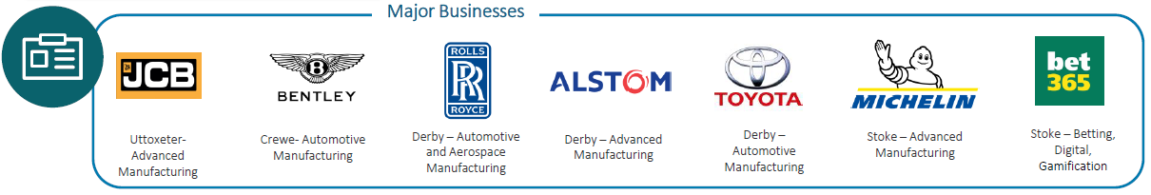



The Fifty500 Investment Prospectus
An exceptional economic opportunity along the A50/A500 to deliver sustainable growth linked to existing industrial, transport and academic assets, supported by the public sector.
Six investment propositions that deliver:
  Drive research and development in high value clustered linked to decarbonised industrial processes and clean energy.
  Drive growth in high value skills and employment for the green economy.
  Provide local energy security.
  Decarbonised vehicle movements.
Builds on and amplifies the business case that Midlands Connect are preparing for road infrastructure investment in the region, but importantly the propositions are not directly linked and can be brought forwards independently all supporting the overarching vision of a decarbonised corridor.

Slide 4
Invest 2035:
The UK’s Modern Industrial Strategy
Supporting the Government’s “National Missions”
Kickstart economic growth
Breakdown barriers to opportunity
Make Britian a clean energy superpower
Relevant Key Sectors
Relevant Priorities
Digital technologies
Advanced manufacturing
Clean energy industries
Defence
Digital and technologies
Life sciences
People and skills
Innovation
Energy and infrastructure
Crowding in Investment
International trade & partnerships
The Fifty500 Investment proposition –
Potential £1.6bn private sector investment unlocked by public sector engagement to deliver 19 projects across 6 propositions
Road to Rail Transition
A transition from road to rail freight will drive a decarbonisation agenda and remove congestion from the passenger road network.
Zero Emission Innovation Valley
A co-ordinated innovation programme to develop a Zero Emissions Valley across the A50/500 corridor.
Regional Supplier Park
Fostering innovation, accelerate development timelines and reduce costs. It will create an employment ecosystem beyond a brand.
Smart Factories
Enabling businesses to be as efficient and productive as possible, whilst attracting highly skilled workers to the region. It will create an employment ecosystem beyond a brand
Innovation Factories
Innovation factories across the corridor will help to create an ecosystem of innovation through cross sector collaboration and business development.
Midlands Industrial Energy Plan
A localised clean fuel supply to power its industrial processes and decarbonised its existing industrial activity.
Builds on and amplifies the business case that Midlands Connect are preparing for road infrastructure investment in the region, but importantly the propositions are not directly linked and can be brought forwards independently all supporting the overarching vision of a decarbonised corridor

Slide 5

Stakeholder engagement
Consultation
Public sector
Cheshire East Council
East Midlands Development Corporation
Stoke-on-Trent City Council
Derby City Council
Nottinghamshire County Council
Nottingham City Council
Staffordshire County Council
Midlands Connect
Private sector
Toyota
Rolls Royce
Brackley Property Development
East Midlands Freeport
Desk based research
Benchmarking and case studies to identify assumption and impacts.
Quantification
Modelled key economic benefits, on an annual basis, for each project.
Notes:
Consultation fee: Determining the value of your expertise

Slide 6
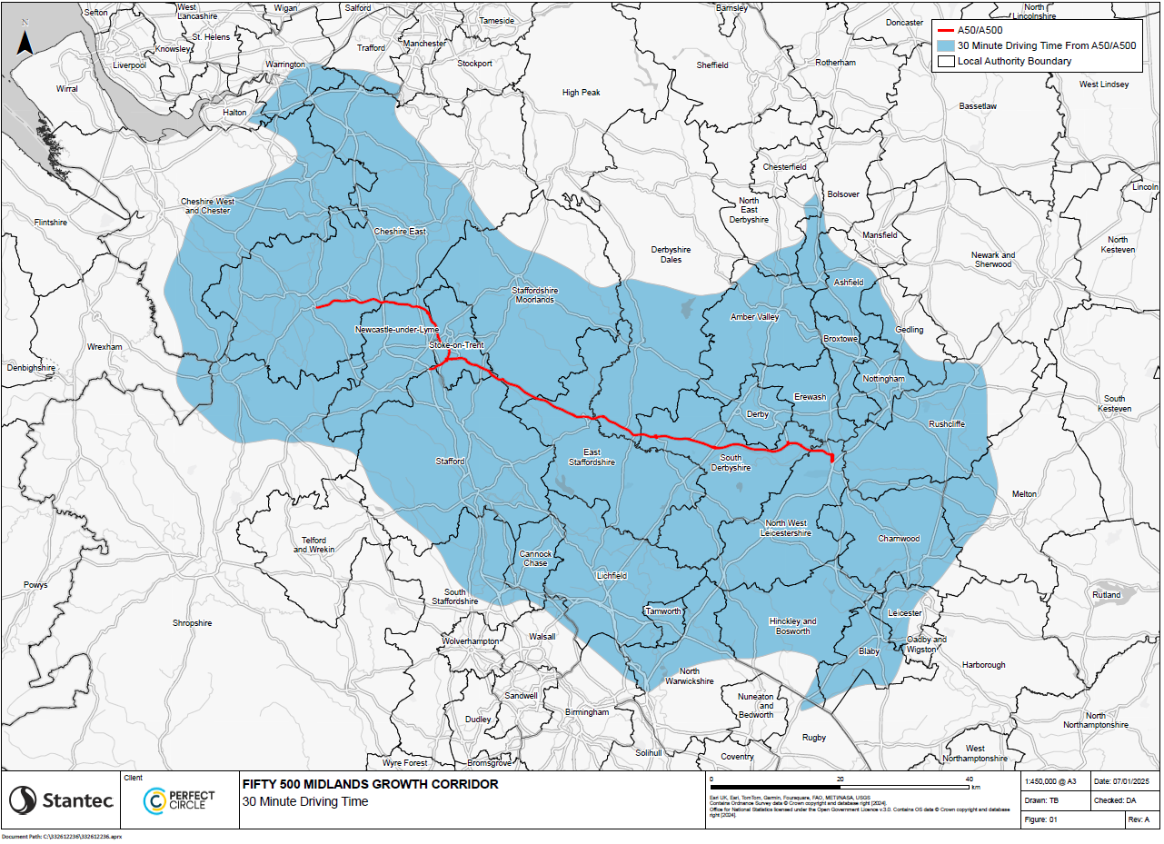

Catchment Area
Fifty500
The Fifty500 area of influence has been determined by drive time analysis and commuting patterns.
Comprised mainly of areas in the East and West Midlands, with strong economic ties extending into key locations in the North West.

Slide 7















Economic Baseline
Economy and Business
Population, Jobs and Gross Value Added
4.00m
1.92m
£117.23bn
Key Assets

Slide 8
Economic Baseline
Economic Trends
Growth in Jobs
GVA Growth
Gross Value Added has grown by 14 percentage points since 2013 and recovered from the COVID-19 Pandemic within 2 years
Economic Forecasts
The Fifty500 Study Area is forecast to grow by 1.6% on average year-on-year until 2070. When it will have approximately doubled in size.

Slide 9

Economic Baseline
Local Labour Market
Qualifications
Economic Activity
High Demand Vacancies
High Value Occupations:
Teaching Professionals
Engineering Professionals
Software Developers
Accounting and Financial Services
Managers and Directors
High Values Industries:
Education
Management Consultancy
Public Administration
Computer Programming
Wholesale and Retail Trade
Wages
Annual Median Gross Wages
Fifty500 Study Area Average - £29,405
Lowest Wage Area - £24,161 Staffordshire Moorlands
Highest Wage Area - £33,842 North Warwickshire
UK - £31,602
Notes:
High value is classified as occupations/ industries with an average wage above the average for the study area. These are the 5 high value occupations/ industries with the most postings.

Slide 10
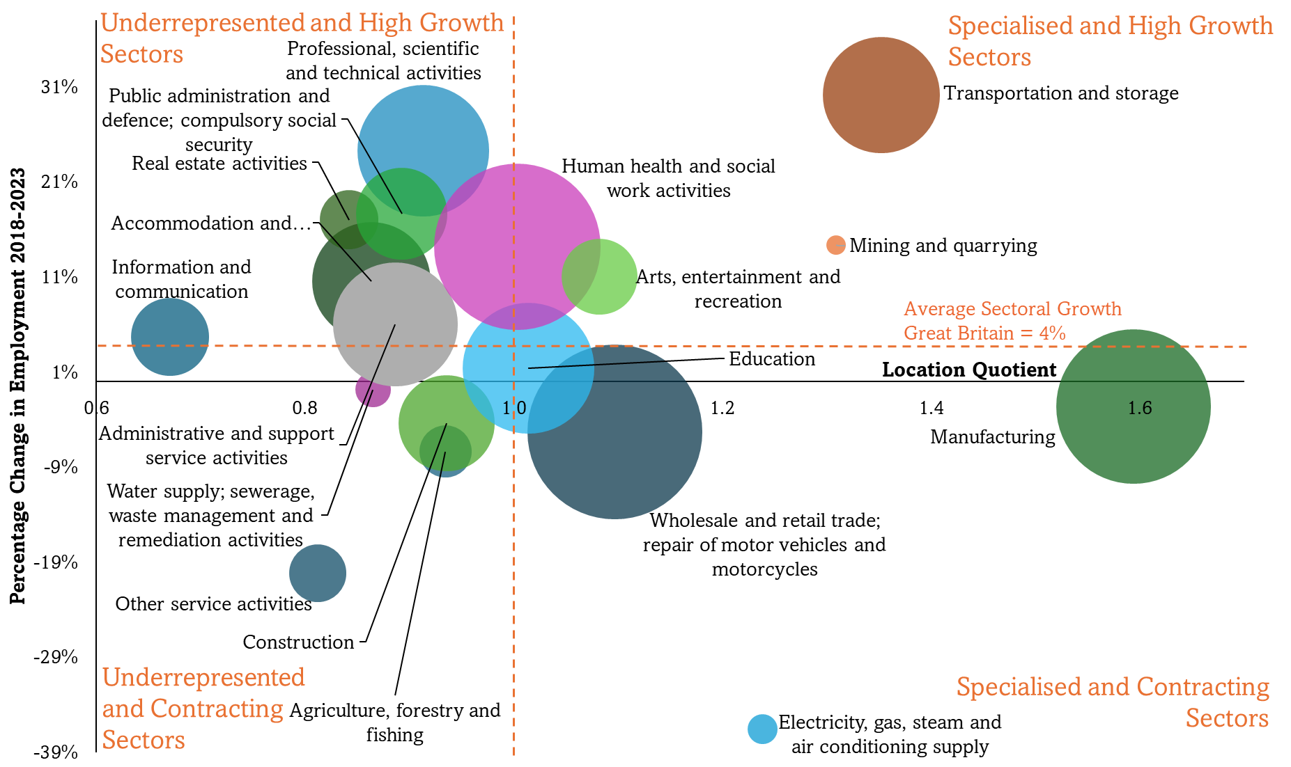
Economic Baseline
Sector Specialisms
Specialised and High Growth –Transportation and Storage
Specialised and Contracting – Manufacturing and Wholesale & Retail Trade
Underrepresented and High Growth – Professional, Scientific & Technical and Public Administration & Defence
Underrepresented and Contracting – Agriculture, Forestry & Fishing
Notes:
Transportation and Storage:
Specialised in terms of employment numbers.
High growth since 2018.
Large employment numbers.
Manufacturing:
High specialised in terms of employment numbers.
Large employment numbers.
Small contraction in size.
Professional, Scientific and Technical:
High value employment opportunities.
Approximately in line with national levels of representation.
Growth since 2018 has been double the national average for the sector.

Slide 11
Aggregate Net Impact, Present Value
Operational Impacts
Net impacts to the year 2070
26,000
£8.97bn
Jobs created
& safeguarded
Gross GVA
Carbon impacts by 2070
86m/kt
£10.84bn
CO₂e reductions
GVA savings
Construction Impacts
Long-term Effects by 2070
8,000
£480m
£9.19bn
Catalytic impacts over time
Gross job years
Gross GVA
GVA

Slide 12
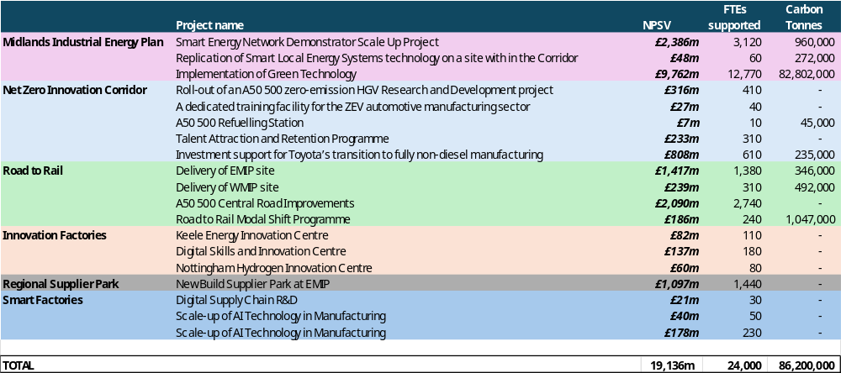
Project level impact estimates

Slide 13
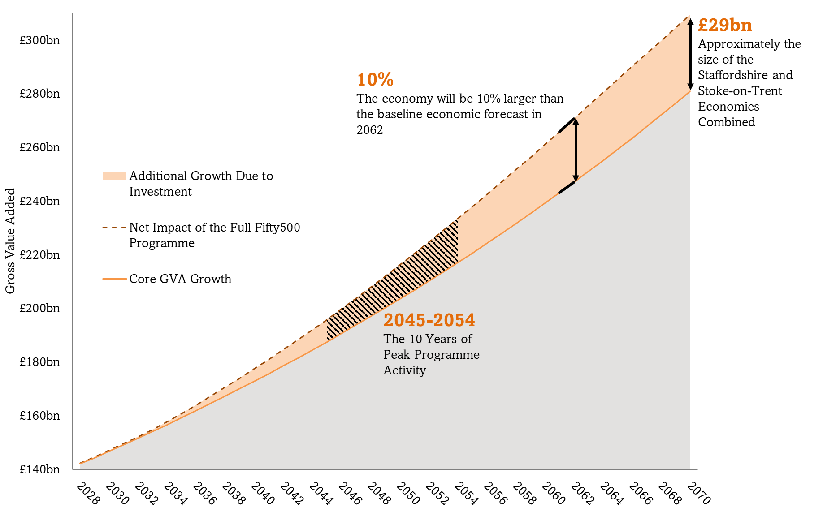
Impact on Economic Growth

Slide 14
Commission Next Steps
Scenario development
    Full delivery (“do maximum”) of all projects within the Prospectus
    Two “do something” scenarios informed by the case study examples identified and the key risk to delivery of the Fifty500 Corridor
Developing HMT Green Book-compliant impact assessment of Fify500 scenarios
  At this stage, we expect to quantify benefits across the corridor including:
    Land value uplift.
    The tax benefits associated with securing better quality employment or moving into work
    Research and development and associated spillover benefits
    Changes to the profile of skills required within the Corridor
    Increase in local wages
Report providing recommendations for each investment proposition and a potential project pipeline which maximises regional economic, social and environmental value and return on investment covering the short, medium and long term.

Slide 15
Corridor Delivery Approach – Further Investment Ask
The following next steps are required to realise the corridor’s transformational opportunity for economic growth:
  Strategic Alliance - Collaboration and Leadership from across Regional Bodies and Businesses to support Business Case Development
  Business Case - A Business Case development programme to deliver a robust case for each of the six propositions and the Fifty500 programme in partnership with HMG
  Government Support - Convergence of key individuals including Government ministers to work with regional leadership
  Investment - Long-term investment into the vision of the Fifty500 Growth Corridor and it’s role in UK regional economic development.
  Our ask of Government is £3M over three years to develop the six concepts into full business cases focusing on priority delivery.

Slide 16
Summary
A transformational economic opportunity along the A50/A500 to deliver sustainable and high value growth.
Six investment propositions that deliver:
  Drive research and development in high value clustered linked to decarbonised industrial processes and clean energy.
  Drive growth in high value skills and employment for the green economy
  Provide local energy security.
  Decarbonised vehicle movements.
An estimated £1.6bn investment to generate £29bn of economic value – a stimulus to the corridor that is equivalent to Stoke-on-Trent and Staffordshire’s economy.
The potential to unlock growth in a nationally significant advanced manufacturing and clean energy corridor, supported by private sector and academic anchor institutions.

