Slide 1




Impact Report
April 2026

Slide 2






Net Zero Go: Pathways to impact
It’s a brilliant, informative website with loads of learning opportunities, plus collaborative case studies and templates that have already been used by other authorities. It’s really easy to sign up and find what you’re looking for. Well done, Net Zero Go!
Carol Thay, Climate Impact Officer Harborough District Council
A digital platform supporting local authorities to accelerate their Net Zero projects, by providing the knowledge, tools, and connections needed for success.
The platform, training, and forums are really informative and helpful. They’ve supported both me and my colleagues in building our understanding of decarbonisation topics.
Capacity
Capability
Collaboration
Net Zero Go builds capacity
The resources on Net Zero Go improved the capacity of its users to deliver projects by accelerating their work, enhancing its quality, and converting risks or unknowns into items for mitigation.
Net Zero Go builds capability
Net Zero Go helped to build the capabilities of local authority officers and Net Zero Hubs users through resources such as e-learning, where users gained new skills, knowledge, and competencies to deliver projects they couldn’t before.
Net Zero Go supports collaboration
Net Zero Go helped local authorities and Net Zero Hubs to collaborate and share insights through the platform’s case studies and Forum peer-to-peer space, as well as facilitating stakeholder engagement activities.
Waste Strategy & Disposal Manager
Dudley Council
Net Zero Library
Articles, case studies, templates, and guides
Net Zero E-learning CPD-accredited programmes to develop Net Zero skills
Net Zero Support
Forums, expert insights, and peer-to-peer learning

Slide 3
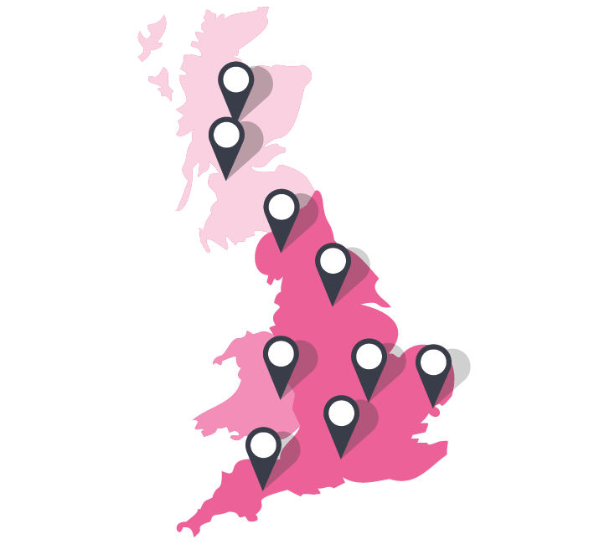
A year of impact
Who we supported

Slide 4
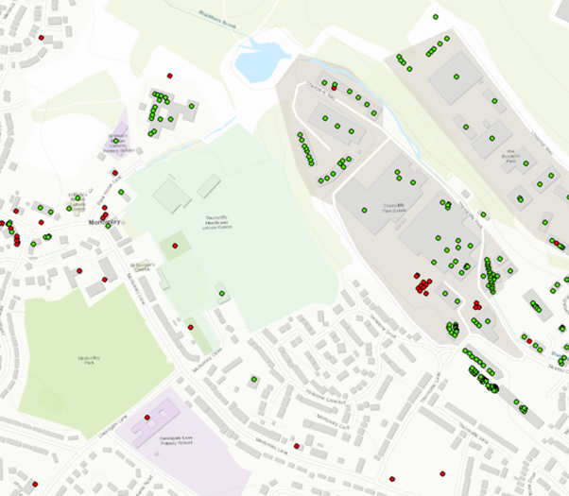

Local authorities
Throughout the year, we listened closely to our users in local authorities.
These quotes show how Net Zero Go is making a real impact.
Capacity
Capability
Collaboration
Senior Energy and Sustainability Officer
District Council
Funding and Project Officer
District Council
Energy Project Officer
County Council
Challenge
‘I’d never worked on a carbon reduction plan before, so I wasn’t sure where to start or what good looked like. I didn’t have clear examples to follow, and found it difficult to speak confidently in team meetings.’
Challenge
Challenge
‘In my role with solar installations, I’m mainly in project management, so I don’t usually get involved in the technical details of how the systems work.’
‘Offsetting is still quite new and there aren’t really set guidelines or standards for local authorities yet, and we just started looking at it at my council.’
Our impact
Our impact
Our impact
‘I went through the business cases you have and kept them in mind when we were developing our carbon reduction plan. I was able to give examples and best practices from what I’d read when discussing the plan with the team, especially around the financial side, which I found most useful. Looking ahead, when we get to writing the financial details, I’ll definitely refer back to those business cases. It’s really helpful to know that resource is there to guide me.’
‘I completed your solar e-learning, and I definitely feel now more competent and confident in those areas. It helped me have better conversations with installers, even when they went into the finer details, and it’s always useful to understand that side of things when planning an installation. It really improved my knowledge and confidence. Another great point is that your courses are now CPD-accredited, which helps when justifying it to managers.’
‘I read through the case studies you have on Net Zero Go and then reached out to the councils that had published the case studies to have a more detailed chat with them. That really helped steer me in the right direction, dismiss a few options at the beginning, and probably saved me a lot of time. It meant I didn’t have to start from scratch.’

Slide 5




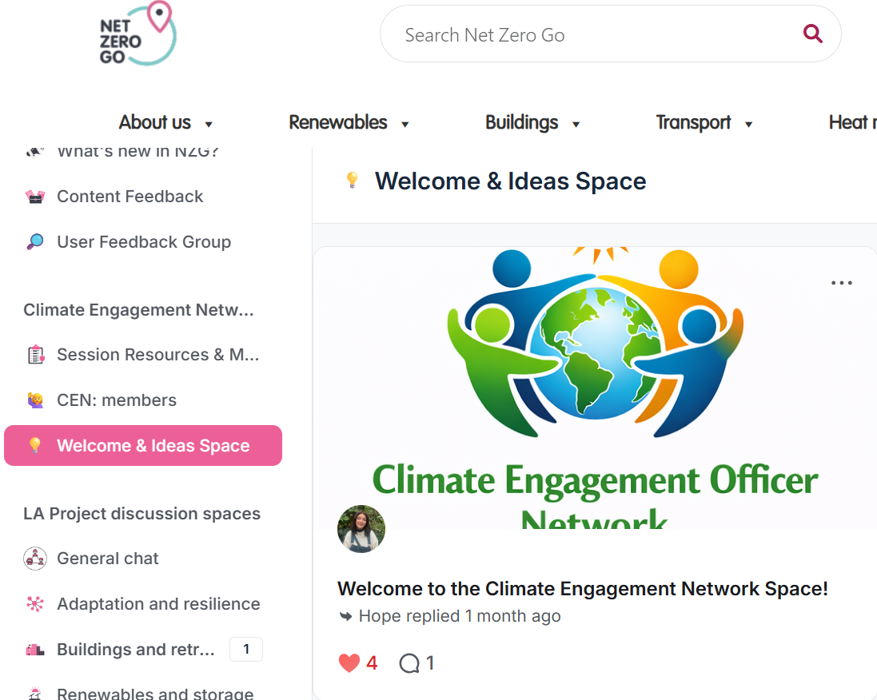

Connecting local authorities
Thanks to the NZG team for setting up this private space for us. It looks great! It’s clear, simple, and really user-friendly. I think it’ll be useful to keep our presentations and events in one place.
Climate Engagement Officer, Hammersmith & Fulham Council
Climate Engagement Network
Case study
Secure space
Our impact
Established a private Net Zero Go forum space for the Climate Engagement Group, bringing together 100+ officers from across different local authorities
Net Zero Go enabled a private Community Forum to support collaboration beyond meetings and emails
Climate Engagement Network
The Climate Engagement Network brings together local authority officers across England to share learning and practical approaches to climate and environmental engagement. Formed during the wave of climate emergency declarations, it began as a small peer-support group and has grown into an informal, collaborative community of over 100 members committed to strengthening public engagement on climate action.
What this enables
One place to share slides, resources, discussion points
Ongoing conversations between bi-monthly sessions
Space to make connections, ask questions, share updates, and learn from peers
A space to shape future topics and drive the agenda

Slide 6





Net Zero Hubs: Impact
As a key strategic partner, Net Zero Hubs are at the heart of Net Zero Go. Here’s the impact they’ve seen:
Trusted, go-to resource
A credible, central library for decarbonisation knowledge, including outputs from strategic Hub-led programmes.
As a key strategic partner, Net Zero Hubs are at the heart of Net Zero Go.
Here’s the impact we’ve seen:
Net Zero Go is the most trusted resource on decarbonisation topics. [NWNZH]
Upskilling teams
Net Zero Go supports learning across Hubs, particularly for new starters, through e-learning, guides, and case studies.
I'd say the platform definitely helped me upskill, especially when I first started working here. It was my go-to if I didn’t fully understand a topic discussed in a meeting. [NWNZH]
Stronger support for local authorities
Net Zero Go makes it easy to quickly find and signpost relevant information to local authorities. With clear summaries and accessible content, it’s simple to identify what’s most useful and direct people to the right resources.
When I had a community energy question from a local authority, I searched for ‘community energy’ and immediately found relevant content, including local authority case studies. The short summaries made it easy to see what was relevant, and I was able to refer them straight to Net Zero Go. Finding something useful so quickly made a real difference and saved a lot of time. [NEYNZH]
Building connections with local authorities
Net Zero Go helps connect Hubs and local authorities. Case studies act as a starting point, making it easy to identify relevant projects and reach out to peers directly. Having that early insight helps set realistic expectations, highlight potential challenges, and support more informed decision-making from the outset.
To me, case studies are there to help you make those extra contacts. I was looking for examples of solar on landfill on Net Zero Go and found a case study from Cardiff. I reached out to Cardiff Council and had a meeting with them last week. It was myself and the local authority I’m supporting on that project, so the meeting was three-way. Meeting with Cardiff gave us a better understanding of what’s ahead; we are aware of all the potential issues, rather than finding out six months down the line. [SWNZH]
Affordable & Social Housing Specialist
Combined Authority

Slide 7



Building a community across Hubs
Net Zero Go brings the Hubs together. There isn’t really anywhere else where they can see what each other are doing. It gives a sense of community. You get to know people from different Hubs and see that everyone’s working towards the same goal.
[NZG Champion, Net Zero Hub]
By building the platform together, we’ve created impact not previously seen for Net Zero Hubs users: bringing people together, not just digital resources.
Stronger cross-Hub collaboration
Regular NZG Champions meetings and shared spaces unlocked connections that wouldn’t have happened otherwise, accelerating project collaboration.
I don’t think I’d be connected to other Hubs otherwise, so it’s been really valuable. For example, I’ve met with another Hub and shared tools we’re using for land assessment, so from the Champions’ perspective [NZG] definitely opened some conversations. [NZG Champion, Net Zero Hub]
Shared space for communication
Community forums on Net Zero Go brought Hubs together and enabled ongoing knowledge exchange.
Accessing information across different Hubs can be tricky, and people still rely a lot on email attachments, which isn’t always practical. Having everything in one place makes a big difference. For example, I picked up the BEMS template that Ed shared on the group on Net Zero Go, shared feedback, and it sped things up. [GSENZH]
Skills for collaboration
Net Zero Go helps build skills for collaboration by bringing people closer to projects and making them a more active part of delivery.
It’s something I’ve really enjoyed [being a NZG Champion]. It’s made me more involved in projects across the Hub, and people now come to me with questions [about NZG], which makes you feel more connected and part of the work. Being the communications person makes you feel quite relevant, and I learnt a lot. [NZG Champion, Net Zero Hub]

Slide 8
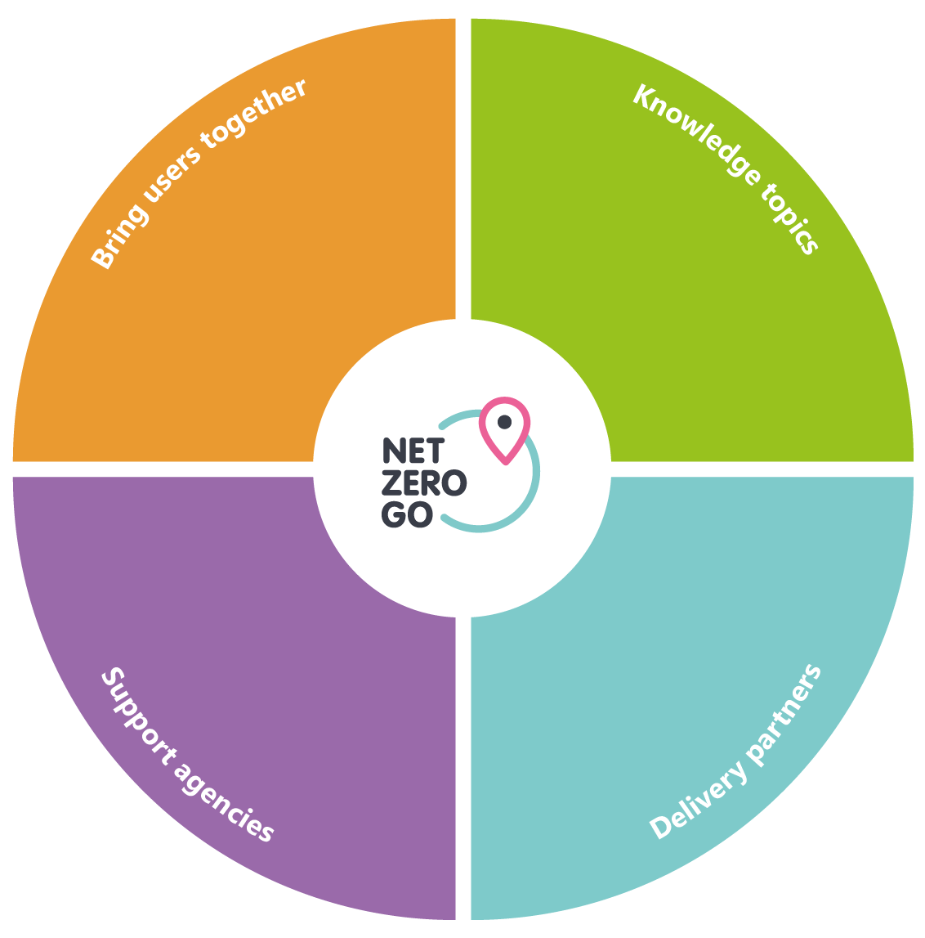

A lasting legacy for Net Zero Living
Challenge
Lasting legacy
As part of the Net Zero Living Programme, Involve delivered public engagement training to 52 Energy Champions officers across England. They needed a safe, shared space to stay connected; one place to continue conversations, access resources, receive updates, and keep the Energy Champions cohort together long after the training ends.
A safe, central place for all programme materials and learning. Without Net Zero Go, valuable resources can become inaccessible or forgotten once a programme ends and funding finishes.
Net Zero Go Community Space
Net Zero Go Library
Net Zero Go Amplifies Impact
Net Zero Go Connects
Connections beyond the programme
Scaling impact
A digital space for collaboration during and after the training ends, allowing for networking and continual learning beyond the original cohort.
By combining a resource library with a shared space, Net Zero Go extends the value of training or programmes beyond the original cohort and amplifies its impact.
Our impact
Net Zero Go created a private space for the cohort to collaborate and continue learning. This will later open up to all users, amplifying the knowledge sharing and connections built during the training.

Slide 9



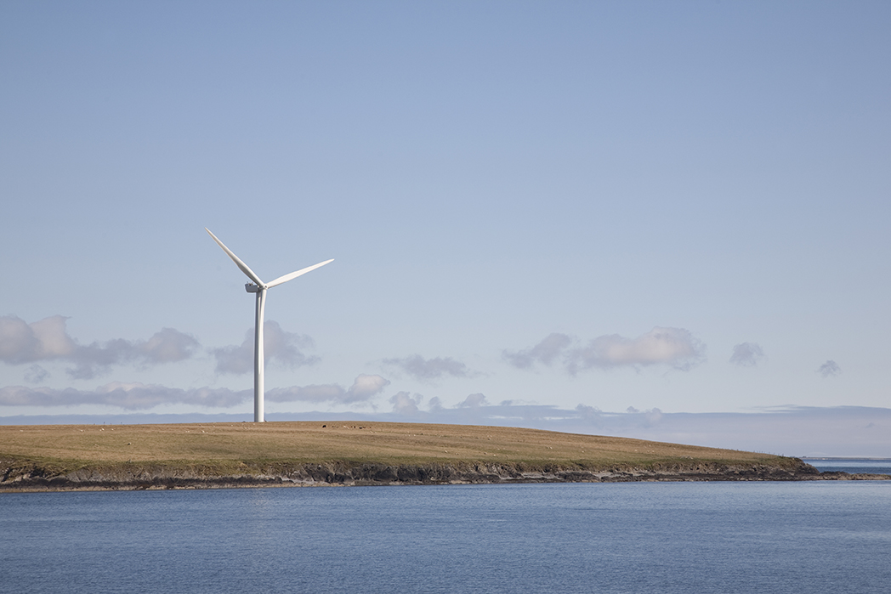
Supporting regional needs and collaboration
Scotland
The platform looks great and is very user-friendly. I know that collating and presenting this kind of information isn't easy, fab work.
Project Officer
Scottish Climate Intelligence Service
Built strong collaboration with the Scottish Climate Intelligence Service to better understand and support Scottish local authority users.
Delivered an onboarding session, successfully bringing SCIS members onto Net Zero Go and strengthening collaboration.
Supporting the launch of an island-focused Net Zero Go Forum Group, bringing together island councils, SCIS, and regional stakeholders.
Continue to work with key stakeholders to bring more Scottish local authorities onto Net Zero Go, and to grow the resource library for Scottish users.

Slide 10
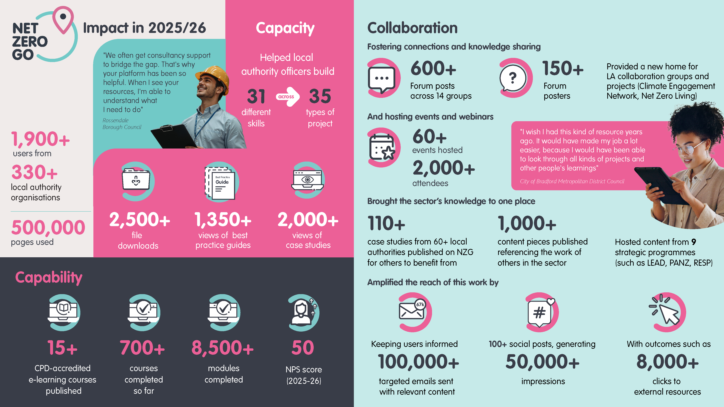

Slide 11
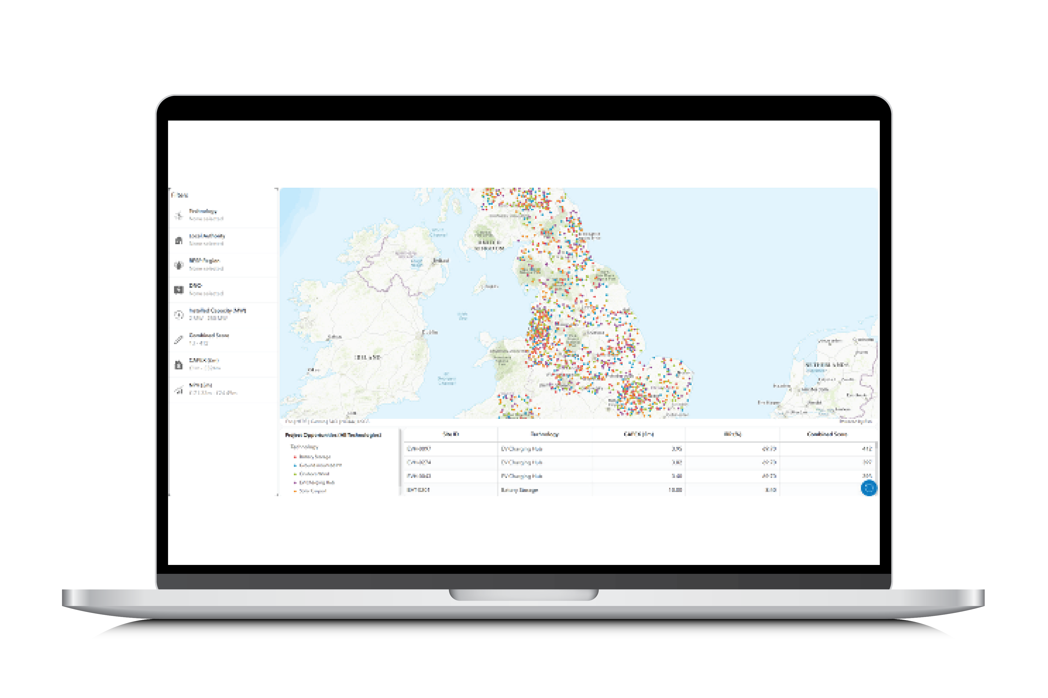
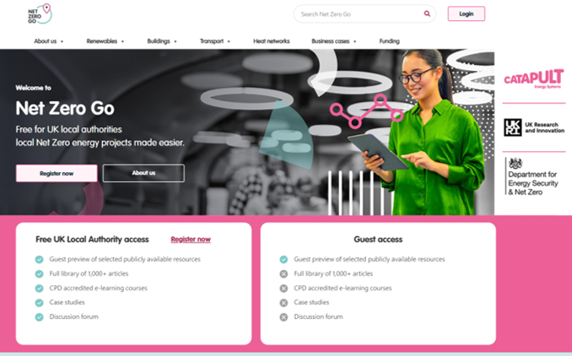

Closing thoughts
We focus on delivering real-world impact by strengthening the capabilities, capacities, and collaboration of local authorities and Net Zero Hubs on their journey to Net Zero. By prioritising outcomes over outputs, Net Zero Go provides practical support that drives meaningful and lasting change at the local level.
We put users’ needs at the heart of everything we build. Through continuous user feedback, insights, and co-creation with local authorities and experts, Net Zero Go delivers accessible, practical tools and ready-to-use resources that support users to take action with confidence.
We believe meaningful change happens through collaboration. By working closely with local authorities, partners, and stakeholders, we can share knowledge, strengthen connections, and accelerate local Net Zero projects together.

