Slide 1


Impact
Report
March 2025

Slide 2



Supporting local authorities to deliver Net Zero faster​
Who does Net Zero Go support
Primary users: Local authority offers in energy, sustainability, transport and estates
Secondary users: Net Zero Hub teams and other public bodies supporting local authorities in the delivery of net zero projects
Also supporting: Procurement, finance and facilities teams plus decision makers involved in Net Zero projects
Key features
Net Zero Library. Articles, case studies, templates, and guides
Net Zero Support. Forums, expert insights, and peer-to-peer learning
Net Zero E-learning. Programmes to develop Net Zero skills and understanding
Net Zero Projects. Step-by-step tools and structured project and business case templates
What does Net Zero Go do
Builds capacity saving time by consolidating trusted guidance, templates and case studies in one place
Builds capability through structured resources, e-learning and practical project guidance
Supports collaboration with expert forum advice and peer-to-peer learning
A digital platform supporting local authorities to accelerate their Net Zero projects, by providing the knowledge, tools, and connections needed for success.
Currently Funded by
Previously Funded by

Slide 3
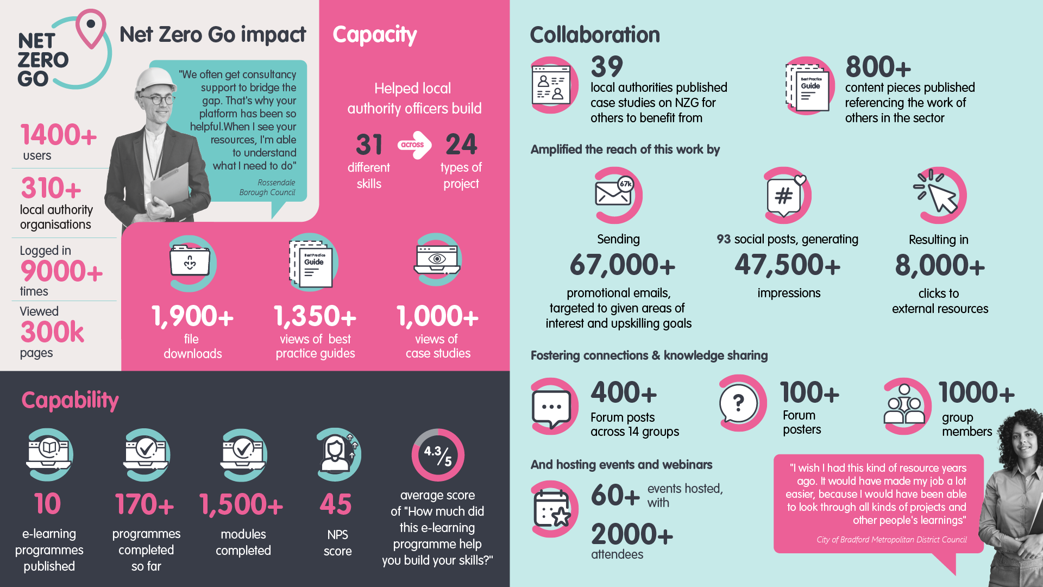

Slide 4
Impact Hypothesis
Impact Hypothesis | Strength of evidence | Credibility of the evidence
Net Zero Go helped to build the capabilities of local authority officers – through resources such as e-learning they gained new skills, knowledge, and competencies to deliver projects they couldn’t before. | Strong evidence | We gathered a comprehensive range of both quantitative and qualitative evidence. We believe this evidence is representative and authoritative, fully supporting our hypothesis.
The resources on Net Zero Go such as best practice guides improved the capacity of UK local authorities to deliver projects by accelerating their work, enhanced the quality, and converted risks or unknown unknowns into items for mitigation. | Strong evidence | We gathered a comprehensive range of both quantitative and qualitative evidence. We believe this evidence is representative and authoritative, fully supporting our hypothesis.
Net Zero Go helped local authorities collaborate and share insights through the platform’s case studies and Forum questions and answers. | Strong evidence | We gathered a comprehensive range of both quantitative and qualitative evidence. We believe this evidence is representative and authoritative, fully supporting our hypothesis.
Our events promoting Net Zero Go helped showcase best practices and encourage cross-regional collaboration. | Strong evidence | We gathered a comprehensive range of both quantitative and qualitative evidence. We believe this evidence is representative and authoritative, fully supporting our hypothesis.
Net Zero Go helped local authorities to make funding applications, which they might not have made before due to lack of awareness, tight deadlines or unclear information. | Some evidence | We gathered evidence suggesting that materials provided by Net Zero Go contribute to a better understanding of what’s needed for a successful funding application. However, further clarity is needed on how these materials directly support securing funding. We will continue to gather evidence in this area

Slide 5



Impact – Capability
"I need concise learning modules that allow me to easily access and absorb key information. I completed your e-learning program and found it highly valuable. Now, I am eager for more content. I am actively seeking additional training and upskilling resources to ensure I feel confident in my ongoing responsibilities."
Mel, Energy Project Officer
In numbers:
How Net Zero Go has helped build capability by upskilling the sector
7 e-learning programmes published
1,300+ modules completed
150+ programmes completed so far
4.3/5 average score of “How much did this e-learning programme help you build your skills?”
Challenge
Similar to numerous energy project officers throughout the United Kingdom, Mel was recently appointed within the Climate Change Team. This position marks her initial foray into such a role. Despite her strong commitment to climate action, she finds herself challenged by the intricacies of the council environment and the complexities associated with net zero initiatives.
Net Zero Support
Like many new energy project officers, Mel turned to Net Zero Go’s e-learning programmes to take charge of her development. She started with Non-Domestic Decarbonisation but soon completed all available courses, building both knowledge and confidence in her role. Now, she’s eager for more learning resources with Net Zero Go.
“Would recommend this to planning & housing teams - to build awareness of low carbon options.”
South Oxfordshire District Council
Net Zero Go impact
Thanks to Net Zero Go, officers like Mel have built essential skills, knowledge, and confidence in net zero projects. As a new staff member in the Climate Change Team, she initially struggled with navigating council structures and managing energy projects. However, through Net Zero Go’s e-learning resources, Mel took control of her learning journey.
"I've completed the non-domestic building decarbonisation e-learning programme, and can highly recommend it to any building officer who is looking to get up to speed on the key things they need to be aware of“
North West Net Zero Hub
“I would recommend this to entry level project officers.”
Derbyshire County Council

Slide 6


Impact – Capacity
‘I needed a clear guide on how to get started, along with references from those who have done this before, and I found it thanks to Net Zero Go. I believe knowing the process and collaborating is the key. I’m happy to share my experiences with anyone, of course, especially when it comes to getting started.’
Alex, Climate Action Manager
In numbers:
How Net Zero Go has helped build capacity by providing trusted resources
29,000+ views of knowledge articles
1,850+ file downloads
1,350+ views of best practice guides
1,000+ views of case studies
Challenge
Alex wanted to accelerate Net Zero projects in his council and was concerned that the climate action plan wouldn’t be specific enough to tackle all the challenges related to the transition from fossil fuels. Alex discovered Local Area Energy Plans online and saw them as the key to driving effective local action in his council. However, he didn’t know where to start in creating his own plan.
“We were working on an application for swimming pool grants, Sports England funding. It was really near to the deadline, through a post on the discussion site I was able to find the information (fund design notes & case studies) and provide to my colleagues writing the bid. It saved us time and we were successful in the application.”
Tandridge District Council
Net Zero Go support
Alex came across Net Zero Go and its guides: "Preparing to Deliver Local Energy Projects" and "Creating a Local Area Energy Plan" with its seven-step methodology, which were clear and concise compared to the other resources he found while searching for solutions online. The eye-opening resources helped him to get started.
Net Zero Go support
For managers like Alex, Net Zero Go has been instrumental in strengthening capacity by offering clear, replicable frameworks that drive progress and improve work quality. Alex is a strong advocate for knowledge sharing and deeply invested in the mission of Net Zero Go. He shared a case study on Net Zero Go to support other local authorities in their Net Zero journey.
“It’s our Google”
London Borough of Barnet
“Financing Local Net Zero Projects – A Guide for Local Authorities” and the associated checklist. It’s particularly relevant to where our LA is … and an area where there is less direct experience in the traditional sustainability, energy, housing teams… it’s converted quite a lot of unknown-unknowns into known-unknowns that we can now work through addressing"
Brighton & Hove City Council

Slide 7


Impact – Collaboration
‘After speaking at your event, we’ve made plenty of contacts, and we’re still in touch with various people. I had quite a few people reach out to me afterward, which was great. Right now, I’m in touch with about 15 other councils. These kinds of events generate a lot of interest, especially from people who don’t know where to start with energy efficiency. I’ve learned a lot from them, so it’s been, you know, it’s not just a one-way thing.’ I’ve had a few conversations with the speaker from Merseyside who’s working on project planning, and I really love the approach they take. The way he structured project planning and how I built on that has made a big difference in how we’re now approaching some of these projects.
Robert, Energy Team Manager
In numbers:
How Net Zero Go has helped connect the sector together and foster collaboration
Published 800+ content pieces referencing the work of others in the sector
Amplified the reach of this work by:
Sending 67,000+ promotional emails, targeted to given areas of interest and upskilling goals
93 social posts, generating 47,500+ impressions
Resulting in 8,000+ clicks to external resources
And hosting events and webinars
60+ events hosted, with 2000+ attendees
Fostered connections & knowledge sharing
400+ Forum posts across 14 groups
100+ posters and 1000+ group members
Challenge
Robert, an experienced Energy Team Manager, has led strategic and operational energy solutions across the private and public sectors for decades. He specializes in decarbonization projects and excels at building high-performing teams while fostering cross-regional collaboration. Though his schedule is demanding, he remains dedicated to sharing best practices and contributing his expertise to the energy community.
Net Zero Go support
Rob’s participation in our June 2024 webinar, Decarbonising Your Estate – Best Practice and Learnings for UK Local Authorities, sparked valuable collaboration among energy project officers. By sharing his insights and best practices, he helped foster connections between local authorities, encouraging knowledge exchange and collective problem-solving.
Net Zero Go impact
After the event, several local authorities, particularly those new to decarbonisation, reached out to Rob for guidance. However, the collaboration was mutual—he connected with a fellow speaker from Liverpool City Region Combined Authority (LCRCA), leading to ongoing discussions. These exchanges have deepened his engagement in knowledge sharing and introduced him to new planning approaches, further enriching his expertise.
"Very useful insights and connections with other LAs that have developed commercial solar programmes, this information will be used as a basis for the development of our own programme"
Surrey County Council
I also find the collaborative aspect really valuable - when other people ask questions you wouldn’t have thought of yourself, and you get different perspectives.
LCRCA

Slide 8

Net Zero Go
Impact
Full Report

Slide 9






In this report
This report presents key data and statistics demonstrating our impact on Net Zero initiatives within local authorities.*
Feedback from Funders & Stakeholders
Qualitative
evidence
Quantitative
evidence
Engagement
Data
Case Studies
We present evidence from approximately 30 interviews with primary and secondary users, funders, and stakeholders
We showcase five case studies highlighting our impact across three key areas: capability, capacity, and collaboration among local authority officers
We present evidence from user surveys, including the impact assessment survey, Net Promoter Score Survey (NPS), and more
We gather and present data from our engagements
We report on feedback from our funders (DESNZ) and key stakeholders.

Slide 10

Qualitative Evidence

Slide 11
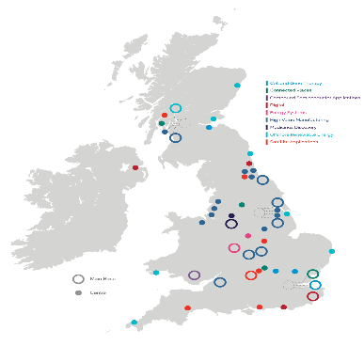



Method & Sample
In Q4, we conducted user research to assess Net Zero Go's impact on the UK’s local authority net zero project landscape.
Local Authority Sample
We ensured a diverse sample, representing a mix of local authority types—including county councils, district councils, unitary authorities, metropolitan boroughs, and combined authorities.
Method
Semi-structured interviews
Conducted online
The majority of interviews took place in January 2025.
Workshop with User Feedback Group (Feb 2025)
Sample
30 participants* in total; including:
17 users (local authority officers)
9 net zero hub users
4 stakeholders (DESNZ, GSENZH)
Research Questions
What impact has Net Zero Go had on the local energy landscape, specifically in building capacity, capability, and collaboration across local authorities?
Persona Type
We balanced our sample with equal representation of early-career officers (first 3 years in post) and experienced officers (10+ years of experience).
Roles
Participants were in generalist roles across various seniority levels. A smaller group of housing retrofit officers provided additional perspective.

Slide 12
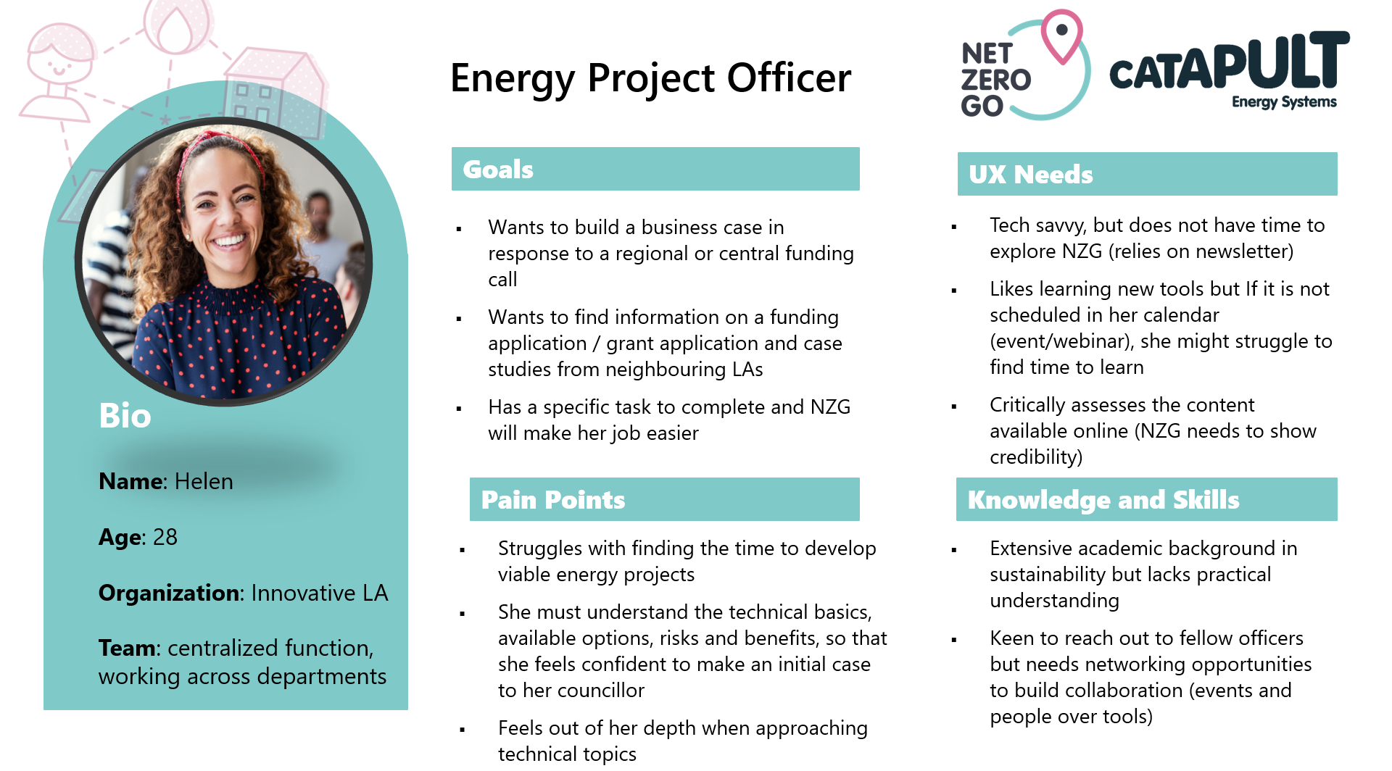
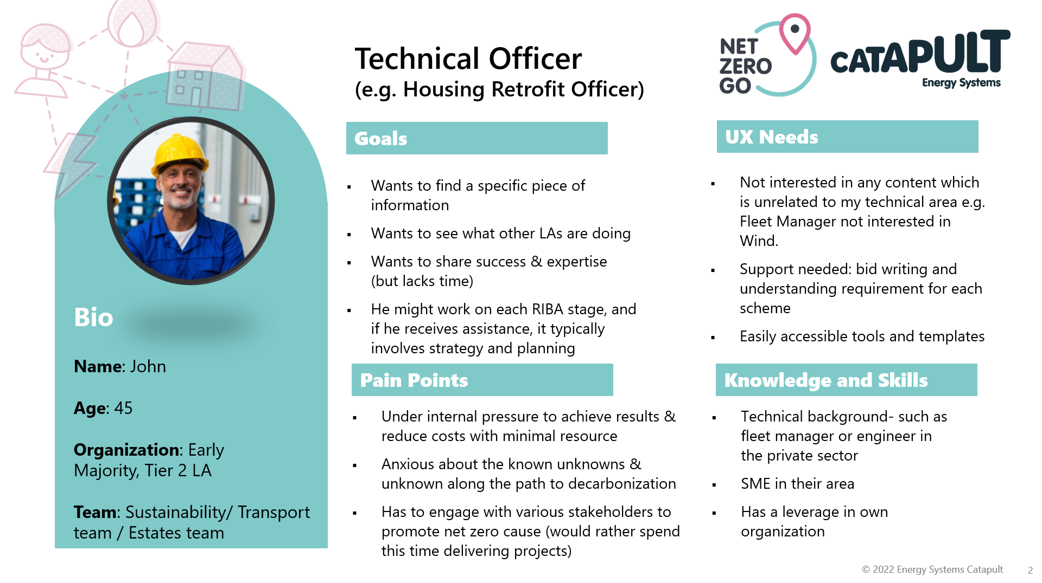
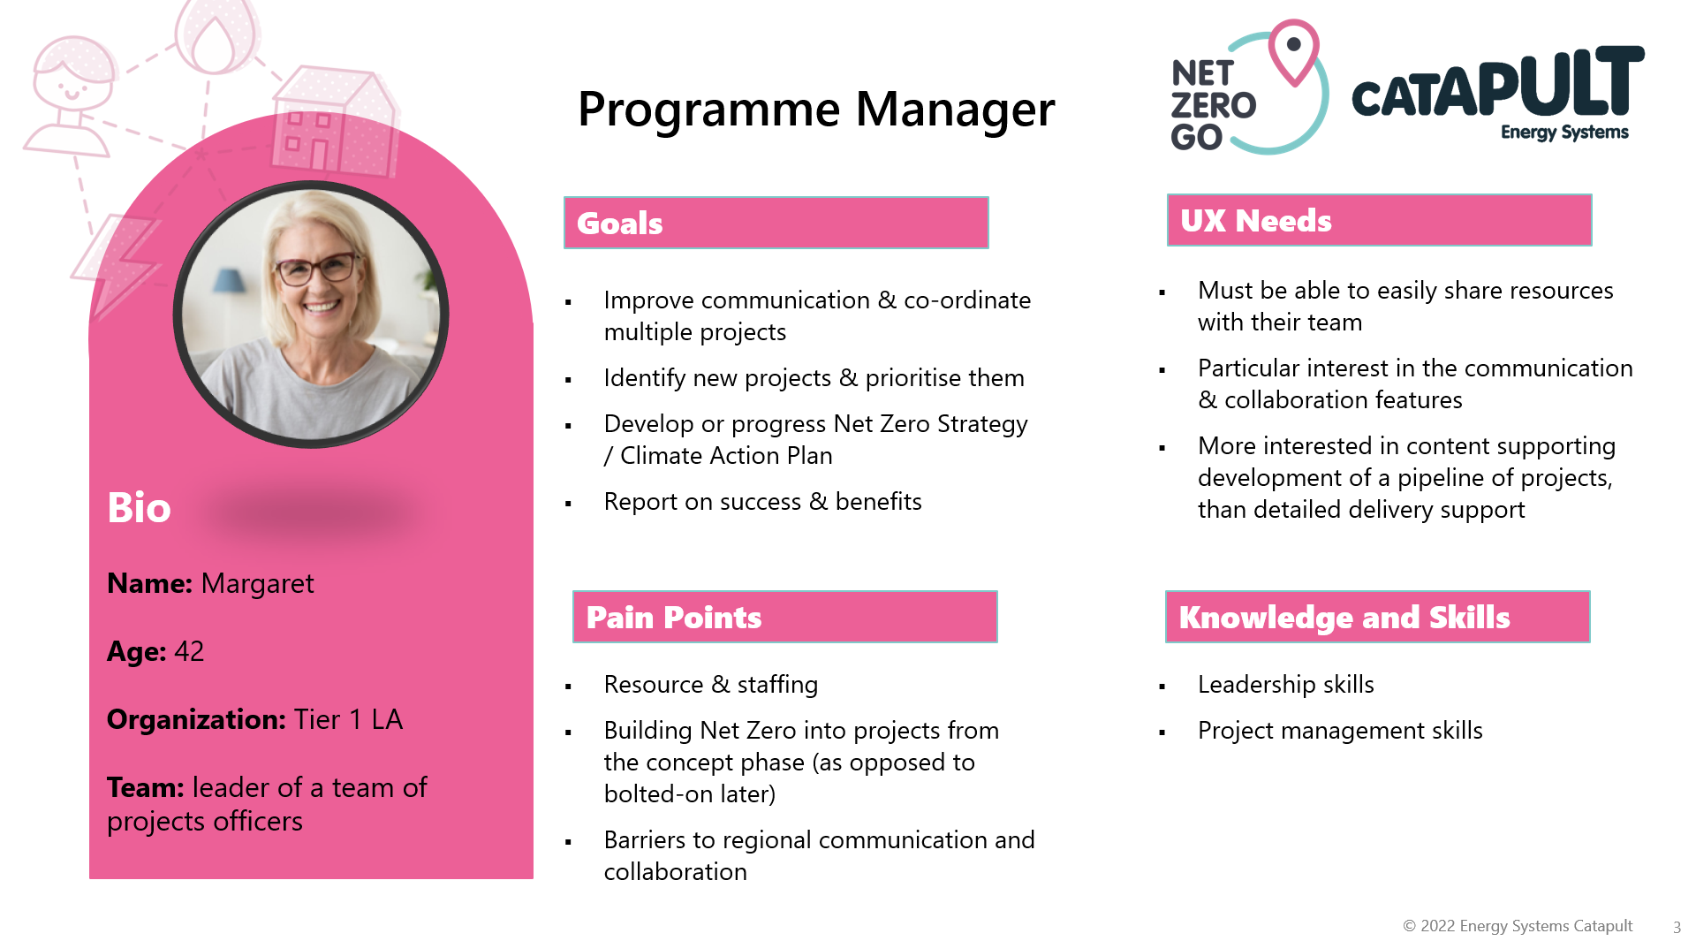
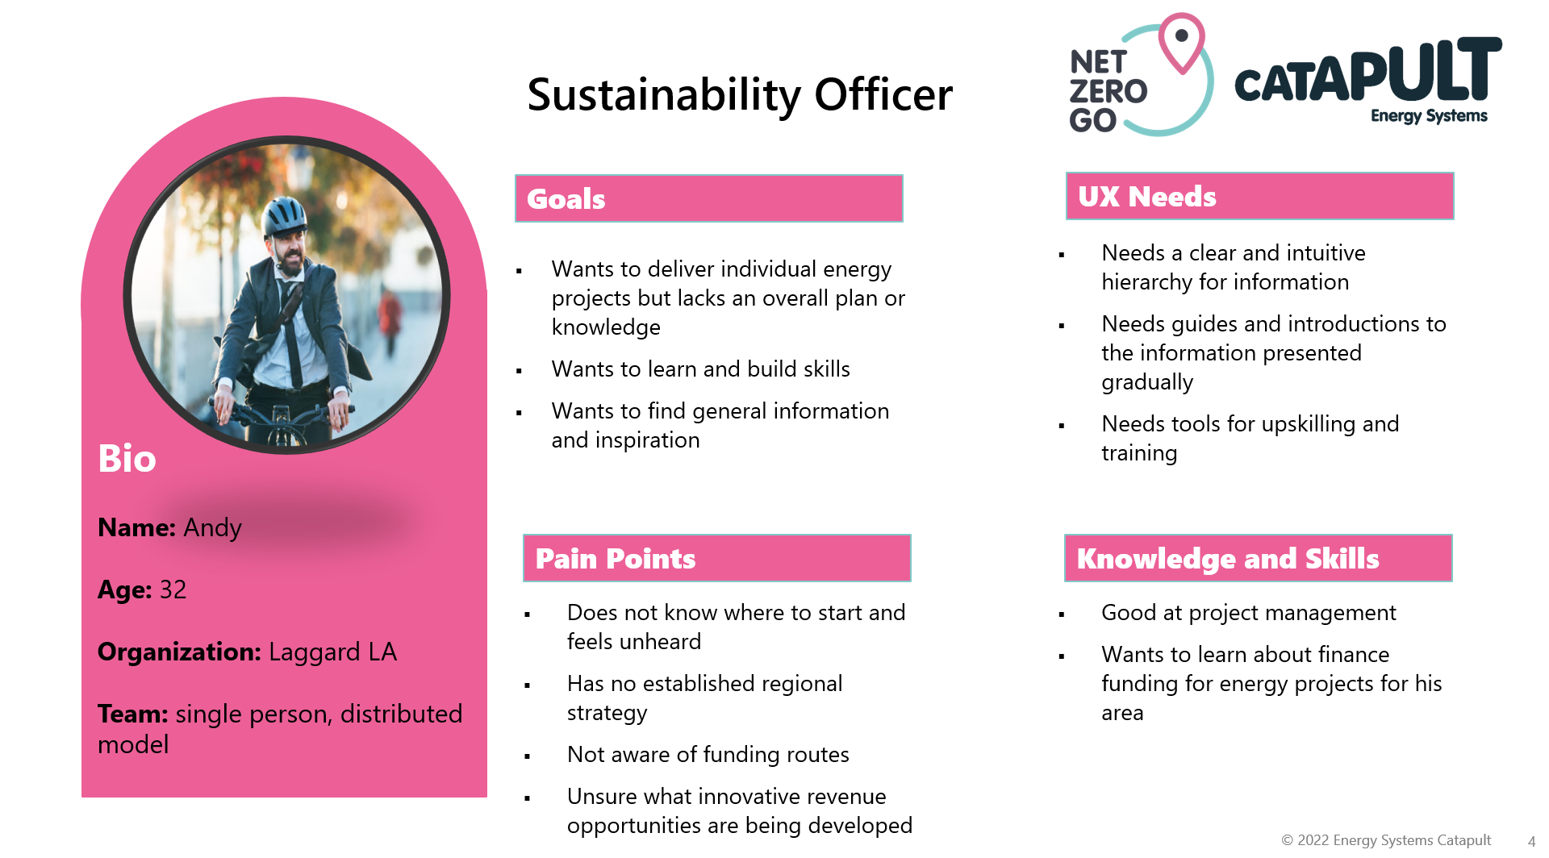
Persona reminder

Slide 13




Net Zero Go – what our users are saying about us?
‘I wish I had this kind of resource maybe 20 years ago, it would have been a lot easier because I would have been able to look through all kinds of projects and other people's learnings.’
John Sharp, Energy Team Manager,
City of Bradford Metropolitan District Council
I like the look of the site, it's clean, contemporary, and not overly cluttered.
You do have absolutely tonnes of information on Net Zero Go!
It’s a great place to find resources when you’re trying to deliver a project. It feels like a more reliable source!
Technical Officer
Energy Project Officer
We should really be collaborating on Net Zero Go to share resource and save time, and come up with something that works for all of us as opposed to us all recreating the same piece of work.
Net Zero Go helps to collaborate rather than everyone starts from scratch all the time
I can check all the necessary items for a decarbonisation project in one place.​
Since membership isn’t restrictive, others working in climate change and energy can access it too.
Programme Manager
Sustainability Officer

Slide 14

Net Zero Go – what our users are saying about us?
I’ve told my colleagues about it. I said, "Look, this is a really good resource, make sure you sign up and go through it!". It’s a great way for all of us to learn more about different topics!
‘I think the service being provided is invaluable. There's still so much more for me to learn, and plenty on the platform that I need to go through to find what’s most relevant.’
Mark Clinton
Waste Strategy & Disposal Manager
Dudley Council
I can check all the necessary items for a decarbonisation project in one place.​
I think it’s come a long way from the original platform I first saw. It’s definitely more user-friendly now, and there’s so much more content available.
Technical Officer
Energy Project Officer
One thing I really value about Net Zero Go is the credibility of the information. Since it’s centrally sourced, it’s unbiased and not influenced by a company pushing a particular approach
Great platform to learn about topics, which were new to me!​
I’ve got a bunch of things bookmarked that I want to go through. There’s so much useful information on there.
Programme Manager
Sustainability Officer
I think it's pretty user-friendly, and you can just dip in and out, using the parts that are relevant to you.

Slide 15
Net Zero Go – one stop shop for net zero projects
I think Net Zero Go appeals to people from different areas and level of experience. I’ve got people in higher management who just need the basics, and they can learn from Net Zero Go. Then I’ve got junior staff who would also benefit from different aspects of it.
‘My direct line manager pointed me to your website for information and I started digging, and must say you do have absolutely tonnes of information on it – I treat as my go to website!’
Ange Ferguson
Project Manager Climate Change
Northumberland County Council
It’s a learning platform - it’s about getting extra information, it’s often about knowing where to start.
There’s been a lot of great work put into it. The fact that you’ve included best practices and case studies - excellent. Being able to see what other councils are doing is really useful
Technical Officer
Energy Project Officer
I’d say the site is kind of a one-stop shop for everything decarb.
Net Zero Go was pretty much everything we’ve been asking for a while.
I’m going to be giving a bit of a speech and a presentation soon on an event for local authorities. One of the things I’ll be saying is that Net Zero Go is a resource you really need to check out.
Programme Manager
Sustainability Officer

Slide 16
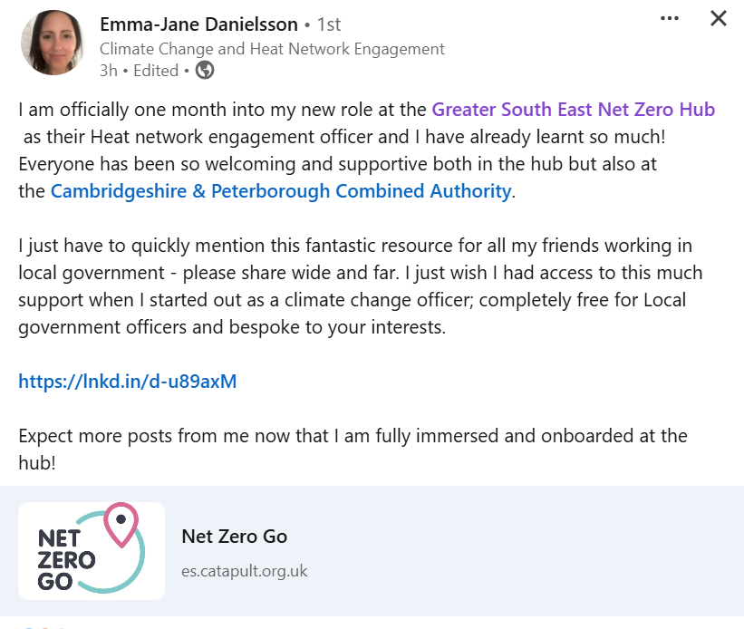




Net Zero Go – what Net Zero Hubs are saying about us?
I love it. I think the platform is fantastic. I really want to get more engagement with it, I promote it whenever I can.
It’s a great place to find resources when you’re trying to deliver a project. It feels like a more reliable source!
Net Zero Go helps to collaborate rather than everyone starts from scratch all the time
Emma Jane Danielson
Climate Change and Heat Network Engagement
Greater South East Net Zero Hub
It’s the place to go for proper processes, rather than just doing a random search on other search engines. This is where you’ll find solid resources, ones that have been created, checked, and tested to make sure they’re reliable.
Net Zero Hub
Regional Project Officer
Net Zero Hub
Programme Manager
You’ve got a whole range of different things, which I think is great. I think you’ve covered it well, the themes are excellent.
Your e-learning is quite clear and concise, and it is very accessible
It was something I had from day one and I still continue to use Net Zero Go all the time.

Slide 17


Capabilities – what our users are saying?
For me, e-learning really cemented my understanding. It pulled everything I had picked up along the way and helped it all make sense. Then it became a matter of figuring out how the different pieces connect, gradually forming a bigger picture. From there, I could break it down again into individual topics. So, from my perspective, it’s been really valuable.
Waste Strategy & Disposal Manager
Borough Council
What we have found helpful is actually reading case studies from other councils. What I really want to see are the difficulties that they've had, a little bit more practical solutions of how they'd ever overcome them.
“I really enjoy your e-learning! I like how it starts with the basics. The non-domestic ones are particularly useful to me right now. You don’t need to be an expert to understand them, which is great. I also have a colleague who uses them, and we both find them really helpful. Even if the topic isn’t directly related to my current projects - like your new module on Funding and Finance - it still gives you good background knowledge. For example, I don’t work in finance, but the Funding and Finance​
e-learnings gives me more confidence in meetings.”
As a new climate officer, I’ve found this very useful. My council hasn’t had a role like mine before, and the information on your site has helped me support staff in their own work areas.​
I’ve mostly used Net Zero Go for interesting articles and training, that’s been the most useful part for me so far.
Because the knowledge on your platform is available at different levels, you can choose the one that suits you best without feeling overwhelmed. You can simply say, 'OK, I’m at early stage, so this is what I need to learn about,'
The decarb journey has been a huge learning curve, and it’s been really helpful to have quality information all in one place. I think that’s what the site really does.

Slide 18

Capacities – what our users are saying?
The most useful part for me was when I used it to create my Low Carbon Skills Fund application. That’s when I used it in the most structured way. I mainly used it to figure out how to put together a heat decarbonization plan. It helped me build an estates decarbonization plan, which I definitely remember came from your website. Overall, I’ve used it for a few different things and dipped in and out as needed.
Sustainability and Climate Change Officer
District Council
I did manage to find I think a guide on local energy planning, to create a local energy plan. I did use that, and it helped me a lot.
It’s like a one-stop shop where I can just think. That’s something you should really shout about: an easy, go-to resource, especially for professionals who might not have time to dig through loads of different sources.
Thanks to your resources I got ahead for writing our business case.
I've used some of the investment tools on Net Zero Go, which was useful.
Yes, it definitely saved me time, once I found the “golden nugget” of information I was looking for!
I'd say definitely time-saving, compared to, you know, searching across websites. We’re able to share that with the partners and then adapt it to the project. So, it gives you that initial overview of what's being done across the field, and then you can tailor it to the local authority. I think that saves a lot of time. You’re not always starting from scratch, which is always a good thing
When I’m looking for something we haven’t done yet, like mapping data centers, it’s a good place to find potential approaches. It saves us from having to contact each council individually, which is what we would have done before

Slide 19
Collaboration – what our users are saying?
There was a webinar with case studies from different authorities that had gone through a decarb journey, sharing their success stories. After your webinar I got in touch with one of the speakers. He used to work with us, so I already knew his name. When I saw him on there, I reached out to him again. Then we met up, and I picked his brain about how he went about it.
Project Officer
Borough Council
Sometimes, it’s difficult to reach out to areas of the country you’re unfamiliar with. Your forum makes it easier.​
I get the emails where people share questions on your Forum, which is great because if it’s something I’m interested in too, I can see how others have responded.
Hearing about what local authorities are going through is it's very helpful [about webinars].
The recent webinars have been especially engaging ,almost addictive, because they fuel my drive to learn, improve, and make a difference.
Your knowledge is often only as good as the last person you spoke to, especially in fast-moving areas like this, where there’s so much innovation happening. None of us have all the answers for getting to net zero so we should generate these networks.
I'm a big believer in networking and sharing experiences, I just think you learn so much from it. Even just talking things through, you start to realize there are things you thought you understood but maybe didn’t fully get. I’m all for on Net Zero Go, and I always say yes to those opportunities [about webinars].
You can ask questions, learn from each other, and there are loads of webinars, tools, and lessons you can pick up.
I especially like the ‘forum' function for people to have an open discussion on the queries raised.​

Slide 20


Case Studies

Slide 21
Case Study – Capabilities
Background
Impact Hypothesis
We helped to build the capabilities of local authority officers.
Thanks to Net Zero Go, they gained new skills, knowledge, and competencies.
‘My previous roles were in broadcasting and higher education. After being made redundant, I attended a bootcamp on net zero, which captivated me and marked the beginning of my career change.
Organisation
Challenge
Similar to numerous energy project officers throughout the United Kingdom, Mel was recently appointed within the Climate Change Team. This position marks her initial foray into such a role. Despite her strong commitment to climate action, she finds herself challenged by the intricacies of the council environment and the complexities associated with net zero initiatives.
‘My council is very proactive in encouraging growth and learning. It was my line manager who pointed out Net Zero Go to me.’
Key pain points
’I am currently taking in a lot of new information and feeling unsure about the next steps. I am experiencing some imposter syndrome with net zero projects and green technology. The council is a completely new environment for me, and I am navigating a steep learning curve.’
Net Zero Support
Like many new energy project officers exploring Net Zero Go, Mel was drawn to the e-learning resources, eager to learn and aware of the need to take charge of her own development. She began with Non-Domestic Decarbonisation, as it was most relevant to her role, but soon found herself completing all the available e-learning; some of it simply to build her confidence in the new job. Now, Mel is excited for more learning opportunities to come.
Key need
“I need bite size learnings to be able to pick up nuggets and pieces and kind of dip in and out.”​
Net Zero Go impact
Thanks to Net Zero Go, local authority officers like Mel have been able to build essential skills, knowledge, and confidence in net zero projects. As a new member of staff in the Climate Change Team, Mel initially struggled with the complexities of navigating council structures and managing energy projects. However, by engaging with Net Zero Go’s e-learning resources, she took control of her own development, gaining technical knowledge in Non-Domestic Decarbonisation and expanding her understanding of broader net zero challenges.
Our impact
‘I went through your e-learning, and I have to say, I completed all of it. Now, I find myself wanting more. I need more! I’m really looking for any training or upskilling resources I can find to make sure I feel confident in what I’m doing moving forward.’

Slide 22

Case Study – Capacities
Background
Impact Hypothesis
We helped build the capacities of local authorities by leveraging replicable approaches, which accelerated progress and enhanced the quality of their work.
‘I had never worked for a council before, so the ways of working were a surprise to me. However, it's been a few years now, and I'm getting used to it. I come from the private sector and have over 30 years of experience in electrical engineering.’
Challenge
Alex wanted to accelerate net zero projects in his council and was concerned that the climate action plan wouldn’t be specific enough to tackle all the challenges related to the transition from fossil fuels. Alex discovered Local Area Energy Plans online and saw them as the key to driving effective local action in his council. However, he didn’t know where to start in creating his own plan.
Organisation
‘Most local authorities rely on third parties or local suppliers to handle these technical tasks, as they don't have their own technical teams or individuals to define their energy strategy.’
Net Zero Go support
Alex came across Net Zero Go and its guides: "Preparing to Deliver Local Energy Projects" and "Creating a Local Area Energy Plan" with its seven-step methodology, which were clear and concise compared to the other resources he found while searching for solutions online. The resources were real eye opening and helped him to get started and understand the whole process.
Key pain points
‘Looking back, the biggest challenge was figuring out how to get started on a local decarbonisation plan.’
Net Zero Go impact
For officers like Alex, Net Zero Go has been instrumental in strengthening capacity by offering clear, replicable frameworks that drive progress and improve work quality. These resources not only provided clarity but also gave Alex the confidence to initiate projects with a strong grasp of best practices. By delivering structured yet flexible materials, Net Zero Go is helping to streamline processes, reducing the time and effort needed to produce high-quality outcomes. Alex is a strong advocate for knowledge sharing and deeply invested in the mission of Net Zero Go. He shared his experiences on the platform to support other local authorities in their net zero journey.
Our impact
‘I needed a clear guide on how to get started, along with references from those who have done this before, and I found it thanks to Net Zero Go. I believe knowing the process and collaborating is the key. I’m happy to share my experiences with anyone, of course, especially when it comes to getting started.’

Slide 23

Case Study – Collaboration
Background
Impact Hypothesis
We helped local authorities collaborate and share insights through the platform, building collective expertise.
‘My title is Climate and Ecological Emergency Officer at Devon County Council. My background is in environmental management, I worked as the Environmental Manager for the RSPB for 10 years before this. I’ve been at the County Council for just over three years now.’
Organisation
Challenge
Margaret is a Climate and Ecological Emergency Officer in the Climate Change team. She works on a variety of net zero projects: energy audits funded by the Low Carbon Skills Fund, producing the Council’s carbon footprint, working with colleagues in Highways on their Carbon Reduction Project, etc. Although she joined the council three years ago, the world of local authorities still feels unfamiliar. She knows that truly understanding the best way to achieve ambitious projects means building a strong network and learning from councils that have successfully delivered similar projects.
Our County Council is a bit ahead when it comes to offsets, so in that sense, we’re pretty innovative. But there are plenty of other areas where we’re not ahead, so there’s still a lot we can learn from others
Key pain points
It’s actually really hard to find people working on similar projects, especially when they’re innovative.
Net Zero Go support
Margaret believes that collaboration and knowledge sharing are essential for successful net zero projects and that it works both ways. That’s why she chose to share her case study on Net Zero Go, not only to help others but also to expand her network and learn from organisations tackling similar challenges. She knows there’s still a long way to go for her council to reach their targets.
Our impact
Not many local authorities have bought offsets yet and it’s still seen as pretty innovative. The Devon case study has definitely caught people’s attention. I regularly get emails from people asking about it. Hopefully, I’m being helpful to those who’ve reached out. It’s all about sharing knowledge and expertise. Take Cambridgeshire, for example, they’re way ahead of us on solar and renewables. Hearing about their experience was really useful since we’re just starting down that road. Worth mentioning, their approach to carbon accounting was quite different. As a result, I have thought again about our approach.
Net Zero Go impact
As a result of the case study, more than 5 local authorities have reached out and Margaret makes sure to respond to each one and to meet up to exchange experience on offsets, including Cambridgeshire County Council. Her conversations prompted her to update key learnings from a carbon offsetting case study and rethink her approach, reinforcing her belief that there’s always something new to learn from others.

Slide 24
Case Study – Events
Background
Impact Hypothesis
Our events promoting Net Zero Go helped showcase best practices and encourage cross-regional collaboration.
‘I have over 40 years of combined experience in decarbonisation projects, sales, and both the private and public sectors.’
Organisation
‘Bradford is well ahead of our carbon emissions targets - far beyond where we need to be. We’re actually doing really well.’
Challenge
Robert is an Energy Team Manager with decades of experience driving strategic and operational energy solutions across both the private and public sectors. With a wealth of expertise in decarbonisation projects across diverse settings, he excels at building and leading high-performing teams. Despite his busy schedule, Robert is passionate about sharing his knowledge, showcasing best practices, and fostering cross-regional collaboration.
Key pain points
‘I want to share our experiences, but personally, I don’t have much time for online forums. I much prefer events and real interactions. Those types of connections work best for me. Maybe it’s because of my age.’
Net Zero Go support
We invited Robert to speak at one of our webinars, "Decarbonising Your Estate – Best Practice and Learnings for UK Local Authorities," which took place in June 2024. As a speaker, Robert shared valuable insights, showcased best practices, and provided practical learnings to help others navigate the challenges of decarbonisation. His expertise and real-world experience made a significant impact on the discussion.
Our impact
After speaking at your event, we’ve made plenty of contacts, and we’re still in touch with various people. I had quite a few people reach out to me afterward, which was great. Right now, I’m in touch with about 15 other councils. These kinds of events generate a lot of interest, especially from people who don’t know where to start with energy efficiency. I’ve learned a lot from them, so it’s been, you know, it’s not just a one-way thing.
It’s been really great to have those kinds of discussions. I’ve had a few conversations with the speaker from Merseyside who’s working on project planning, and I really love the approach they take. The way he structured project planning and how I built on that has made a big difference in how we’re now approaching some of these projects.
Net Zero Go impact
After the event, several local authorities reached out to Robert, particularly officers who were just beginning their decarbonisation journey. But for Robert, the impact of collaboration wasn’t one-sided. He also connected with a fellow speaker from the Liverpool City Region Combine Authority (LCRCA), whom he has since met a few times. Through these exchanges, he has actively engaged in knowledge sharing and discovered new approaches to planning, enriching his own expertise.

Slide 25


Case Study – GSENZH Learning Group
‘One of the main challenges, I think, is that as people get busier, they don’t always find the time for learning and knowledge sharing. The hubs are designed for sharing knowledge with local authorities and the public sector, but sometimes I think we forget that within the hub itself, we all have valuable knowledge to share with each other too.’
CHALLENGES
Knowledge Gap
Net Zero Hubs Regional Energy Project officers are expected to be specialists in one area while catering to a wide range of projects. There is often a knowledge and skills gap, particularly for early-career Energy Project Managers (EPMs).
Time Constraints
With a busy schedule, it’s challenging to accommodate upskilling and learning about new Net Zero topics. EPMs want to engage with credible knowledge related to energy projects, which they can then share with local authorities at different levels of Net Zero maturity. Perhaps more importantly, while learning about new Net Zero topics, they want to understand the challenges local authorities face when approaching Net Zero projects and gain real lessons learned from projects that have been delivered in the past
Remote work
Remote work can make it harder for natural knowledge sharing to happen, the kind that would naturally occur through conversations in the office. As a result, more junior team members can sometimes miss out on the internal knowledge and expertise held by their more senior colleagues

Slide 26
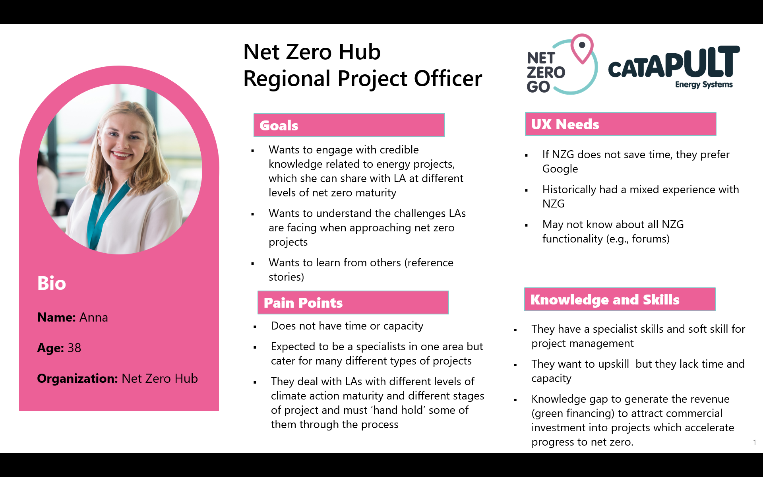
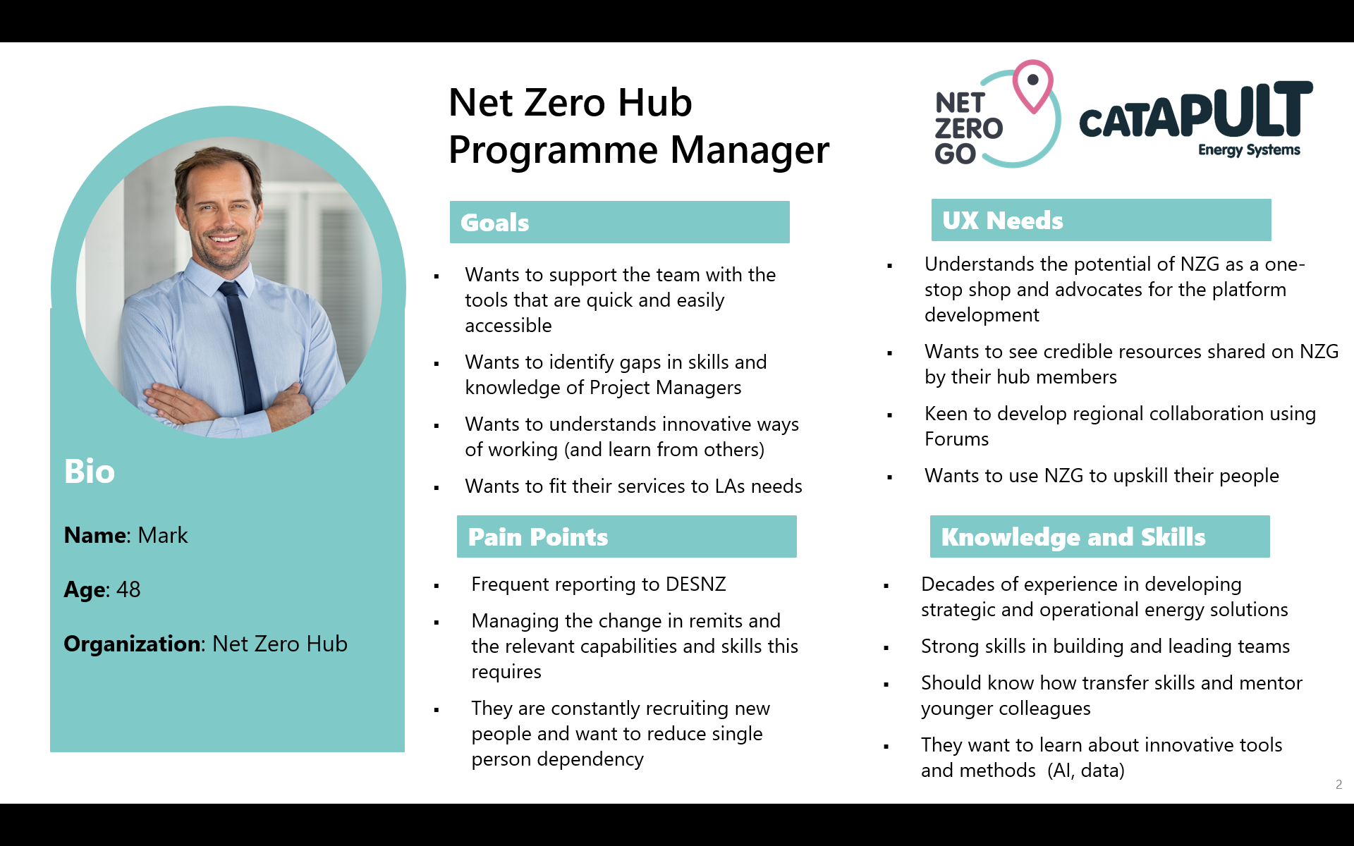
Case Study – GSENZH Learning Group
It’s a chance to take in knowledge, ask questions, and contribute by sharing any insights we’ve gained along the way.
SOLUTION
What is it?
A team of 12 EPMs from GSENZH explores a different topic each month through the platform. Each month, they come together in an online workshop to share learnings, ask questions, and provide feedback on Net Zero Go resources.
What’s in it for GSENZH?
Facilitate a collective learning journey on the topic of net zero through monthly group sessions. Suggested discussion questions for these sessions include: What did we learn?
What knowledge gaps exist? What should we do next?
Utilize Net Zero Go as a learning tool by aligning its topics with the team's identified knowledge gaps and upcoming work priorities.
Support internal knowledge sharing in the era of remote working by fostering open discussions around knowledge gaps and areas for growth.
Promote a "lunch and learn" format to encourage team building and the sharing of experiences in a relaxed setting.
Encourage knowledge and experience exchange among energy project managers across different seniority levels to foster growth and collaboration.

Slide 27
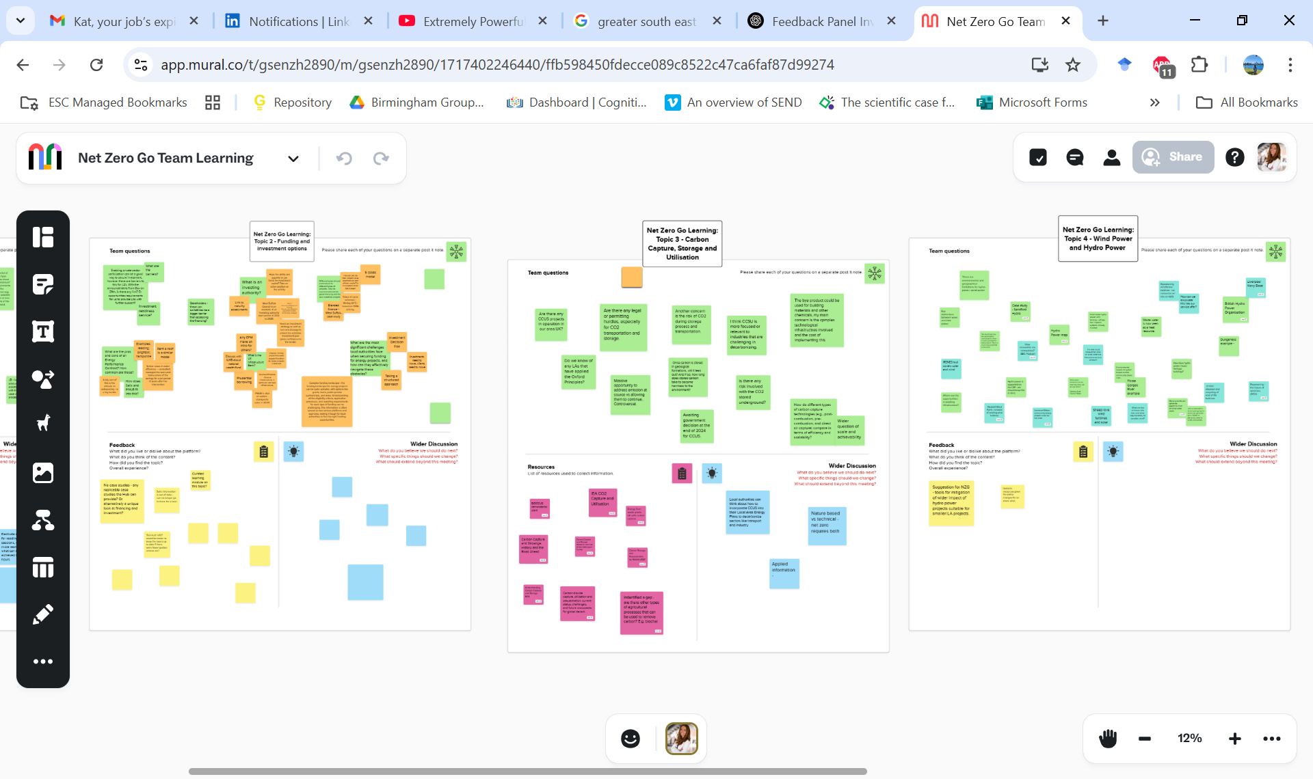

Case Study – GSENZH Learning Group
‘It’s something to look forward to each month because you know you’re going to learn something from someone else, and that’s such a big part of your work life. Without that group, even though we have meetings where we pick up things, this group is specifically focused on learning. And I think that’s what makes it so valuable.’
PROCESS
Step 1
Choose a chair and an operational lead to be responsible for scheduling meetings, sending reminders, keeping track of topics, and chairing a monthly one-hour meeting. These meetings can be organized in a casual ‘lunch & learn’ format online.
Step 2
Plan monthly meeting topics to align with upcoming projects, team interests, and identified knowledge gaps. Building enthusiasm and securing team buy-in before launching the program is essential - without genuine interest, participation may feel like a chore rather than a valuable growth opportunity.
Step 3
Set clear expectations and structure the workshop effectively. Using a Mural or Miro board can provide a collaborative space for everyone to share insights, learnings, and questions. Suggested discussion questions for these sessions include: What did we learn? What knowledge gaps exist? What should we do next?

Slide 28

Case Study – GSENZH Learning Group
‘For me, and I know for the other energy project officers as well, these groups are really important for our learning, especially early in our careers. They give us the chance to be like sponges, absorbing the knowledge that senior members have. When you're working remotely, you don’t get those passing office conversations that just happen naturally in person.’
LEARNINGS
What were key learnings so far?
Team buy-in and enthusiasm are crucial for meaningful participation. Preparing the team and managing expectations are the most important first steps.
Defining session frequency, format, and commitment levels ensures clarity and sustainability.
A dedicated facilitator and a predictable schedule help maintain momentum.
The programme evolved into a broader self-directed learning model rather than being solely focused on the Net Zero Go platform. Encouraging external resource exploration has helped bridge content gaps.
Balancing different workloads makes scheduling tricky. A flexible approach, including asynchronous participation during busy periods, can help keep the programme manageable.
Creating an inclusive and friendly atmosphere, and inviting team members to choose topics, can foster ownership, curiosity, and commitment.
The initiative has fostered a stronger culture of learning, knowledge-sharing, and collaboration.

Slide 29




Case Study – GSENZH Learning Group
‘We have been pleasantly surprised by how much this initiative has strengthened team relationships as a team who work fully remotely, it’s fostered a culture of collaboration and curiosity that extends beyond the sessions.’
In our sessions, there’s no such thing as a ‘stupid question’, everyone’s encouraged to speak up, and it’s all about making sure the quieter voices get heard.
It’s a chance to take in knowledge, ask questions, and contribute by sharing any insights we’ve gained along the way.
IMPACT
Net Zero Hub
Regional Project Officer
Net Zero Hub
Programme Manager
Impact for Net Zero Go
Exposure to internal expertise and knowledge of senior members of the hub, sharing diverse resources beyond Net Zero GO (books, podcasts, videos, external research)
Having a clear structure and workshop format in place ensured that junior members felt supported in their learning journey.
Encouraging autonomy over learning topics increases engagement, curiosity, and ownership over own learning journey at junior level.
Junior EPMs involved in the organization of the group can practice operational skills, effective communication, and information synthesis, boosting their confidence.
Collecting ongoing feedback and constructive criticism from energy project managers (EPMs) on content, information architecture, and structure.
Identifying gaps in the existing content on Net Zero Go and opportunities for improvement and growth.
Recognizing other sources of knowledge currently utilized by EPMs beyond Net Zero Go.
Identifying tools and resources that could be shared and published on Net Zero Go.
Highlighting new and upcoming resources or toolkits in development that could be added to Net Zero Go.
Fostering strong relationships with the hub to build long-term partnerships and promote knowledge sharing.
Enhancing the outreach of Net Zero Go among members of Net Zero Hubs.
Promoting Net Zero Go as a valuable learning tool, co-created with input and expertise from hub members
Creating a culture of collective learning within the team and practicing open and inclusive discussion.
Providing an inclusive and welcoming atmosphere helps build ownership, curiosity, and commitment to learning within the team.
The initiative has strengthened remote team relationships, created great team building activity, a more collaborative and supportive environment.
Helps address knowledge gaps, even for more senior members, as the learning format is structured yet flexible, allowing each EPM to choose learning outcomes that suit their level.

Slide 30

Insights

Slide 31





Key Insights - Capabilities
Trusted source for upskilling
Net Zero Go was consistently recognized as a trusted and credible resource for knowledge building within the local authority community. Users particularly valued its guidance, highlighting how it provided much-needed clarity on where to start.
‘For me, the training has definitely been the most valuable part. You’re trying to take in all this new information almost all at once, and you’re not sure what steps to take!’
Project Manager Climate Change
County Council
E-learning supports both early-career and experienced officers
The e-learning platform not only caters to early-career personas but also consistently receives feedback from more experienced officers (Helen+). Users highlighted that, even with prior knowledge, e-learning provided valuable reassurance and boosted confidence.
‘I’ve been in this role for about three years now, which isn’t very long, but it should be long enough to feel fairly competent. For me, going through the courses on things like domestic and non-domestic building retrofits is really reassuring. I might already know a lot of the content, but it gives me confidence that I haven’t missed anything
new or important
Sustainable Development Officer Unitary Council
Bridging the knowledge gap for generalists
For many officers, building capabilities, both in knowledge and skills, represented a significant learning curve. Evidence shows that Net Zero Go and specifically e-learning effectively fills this gap, providing accessible and user-friendly content that supports basic learning and technical knowledge, particularly for generalist and non-technical officers.
‘None of us come from technical backgrounds in engineering or construction, so it can sometimes be tricky to figure out what level of knowledge we actually need. I think that’s where Net Zero Go really helps, by looking at technical expertise but presenting it in a way that’s accessible
for people like us who don’t have that background.’
Housing Retrofit Officer
Unitary Council
The strongest evidence of impact on capability
The strongest qualitative evidence of capability building comes from the least equipped users (Helen) who are actively working to develop their competencies. This effort highlights a clear need for tailored training at various levels, based on the specific knowledge required. Net Zero Go is seen as an essential resource in supporting both professional development and career progression for these users.
As a team, we're developing a competency framework to map out key skills at different levels and trainings. We’re pulling together various resources, It’s a big piece of work, we will be adding Net Zero Go to it. Some training levels are straightforward, but others might vary depending on job roles, career paths, and the level of knowledge needed. The goal is to make sure the framework supports both professional development and career progression
Housing Retrofit Manager
Combined Authority

Slide 32
Key Insights – Capacities
This [Net Zero Go] is where you’ll find solid resources, ones that have been created, checked, and tested to make sure they’re reliable. I think that saves a lot of time. You’re not starting from scratch, which is always a good thing!
Net Zero Go saves time
Across qualitative data, there was clear and very strong evidence that Net Zero Go is helping local authority officers save time by providing ready-to-use resources and examples from other projects in one place.
Planning Officer
Unitary Council
Net Zero Go accelerates the progress
User interviews confirm that Net Zero Go resources help accelerate work while providing reassurance that outputs are based on high-quality, expert-tested materials. However, some users struggled to pinpoint exactly which Net Zero Go resources they used, as they were simultaneously accessing multiple websites and knowledge sources
I accessed NZG between 6-12 months ago and I did manage to find I think a guide on local energy planning, to create a local energy plan. I did use that, and it helped me a lot.
Sustainability and Climate Change Officer
District Council
Building for the future capacity
Among those who haven’t actively used the tools or templates (or struggle to recall which ones they’ve used) there is a strong sense of confidence in knowing that a reliable repository of guides, tools, and templates is available whenever needed
I just wanted to get a sense of what’s included in your business case templates, whilst we are waiting on templates from the West Midlands, I’ll be looking at your business cases and the examples available so I can get ahead of the curve in preparing ours.
Low Carbon Programme Officer
Unitary Borough Council
I’ve made sure to update my interests on Net Zero Go, because, while I’m interested in everything, I don’t have the capacity to do it all! Your Dashboard helps me prioritize what’s directly relevant to my work right now.
UX Improvements boosted efficiency
Some users, in retrospect, shared that recent UX improvements to the platform helped them save time, quickly access resources, complete tasks more efficiently, and stay engaged. By enhancing the UX, we’re reducing cognitive load.
Affordable & Social Housing Specialist
Combined Authority

Slide 33
Key Insights – Collaboration
Evidence for collaboration building
Net Zero Go is seen as a trusted platform, with users willing to engage and support others by sharing their knowledge. Net Zero Go offers an opportunity to peer-to-peer learning, connecting, asking questions, and exchanging expertise.
I’ve responded to a few requests coming from Net Zero Go, sometimes I get emails from people asking for information or looking for guidance and I am happy to help.
Climate Change and Sustainability Project Manager
Borough Council
Collaboration – impact behind the scenes
After your webinar I got in touch with one of the speakers. He used to work with us, so I already knew his name. When I saw him on there, I reached out to him again. Then we met up, and I picked his brain about how he went about it.
Measuring the direct impact of collaboration is challenging, as responses vary widely. While some users reported increased interest, and a stronger sense of community, others engaged through emails, LinkedIn, or in-person meetings. This spectrum of impact highlights the diverse ways people respond. Additionally, reaching the right audience at the right time remains a key factor in maximizing the effectiveness of these events.
Project Officer
Borough Council
Webinars – informal learning
I find [Net Zero Go] webinars really useful. Especially when they bring in different perspectives or cover topics you haven’t come across before. I also find the collaborative aspect really valuable, when other people ask questions you wouldn’t have thought of yourself, and you get different perspectives. It’s not formal learning, but honestly, some of the most interesting things that have led me to explore new topics have come from webinars rather than trainings.
Webinars are a powerful informal learning tool, offering diverse perspectives and peer-driven discovery beyond traditional training. The interactive discussions and questions often create the most valuable insights. For Net Zero Go, this highlights the importance of keeping webinars engaging, collaborative, and thought-provoking to drive real impact
Net Zero Projects Graduate
Combined Authority

Slide 34
Key Insights – Collaboration
Two-Way collaboration exchange
Local authorities are highly collaborative and value the exchange of resources and outputs, with a strong focus on two-way communication, even if some of it is informal. Net Zero Go facilitates the sharing of resources, insights, and best practices, while enabling effective collaboration.
I get emails asking about the case study posted on Net Zero Go. I always tell people who contact me that I'm happy to meet up, and it’s led to some really useful conversations. Everyone has their strengths and weaknesses, and what an organisation achieves often depends on factors like personal interests, focus areas, and what politicians are willing to support. So, everyone will be at a different stage depending on where they’re at.
Climate change officer
County Council
Collaboration bystanders
Evidence shows that users value the opportunity to engage with discussions in the forum, not necessarily by asking questions themselves, but by observing and learning from the questions and insights shared by others. Forum groups enhance the user experience by fostering a safe and secure community-driven space where users can gain knowledge and insights, even if passively.
I’ve used some of the chat room features [on Net Zero Go], not necessarily to ask questions myself, but to see what others have asked and make use of the discussions.
Climate Change and Sustainability
Project Manager
Borough Council
Shared challenges foster collaboration
A sense of shared challenges helped to unite users to share resources and learnings. Shared struggles foster a sense of community and collaboration. By addressing these challenges together on Net Zero Go, we can strengthen collaboration and users' investment in the platform.
The Council set the target with a lot of hope and ambition, but without really understanding how it would be implemented. Now that we see how tough it actually is to deliver, we’ve got to be realistic and make it manageable for ourselves. I think many councils are in the same position and we can understand each other.
Project Officer
Borough Council

Slide 35


Quantitative Evidence

Slide 36






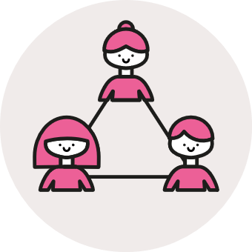
Surveys
We gathered impact feedback through multiple surveys:
Together, these surveys provide quantifiable evidence of our impact on capabilities, capacities, and collaboration, offering a complete picture when considered alongside each other.
Impact Survey
NPS Survey
Navigation Survey
Guide Survey
Post e-Learning Survey
Brief Overview
Impact Survey
Impact Survey Key Insights
Sample & timeframe
23 anonymous Net Zero Go users
Jan & Feb 2025
Capability
Capacity
Collaboration
Purpose
Assessing impact against capability, capacity, and collaboration
Survey confirmed that the platform is effectively helping users streamline their work, save time, and help to plan and deliver projects.
The positive feedback (with around 65% agreement) across suggests that the Net Zero Go platform is making a measurable impact on knowledge-building, confidence, and understanding.
Net Zero Go is successfully facilitating knowledge-sharing between local authorities.
Key Takeaway
Strongest agreement on improved knowledge, but mixed feedback on capacity building.
Caveats
These results should be considered with the caveat that the sample size is small (less than 1% of our users)
There was a high proportion of neutral responses across the survey, particularly in capacity-building (up to 60%)
.
*For more detailed survey analysis, please see the Appendix

Slide 37



Net Promoter Score (NPS)
Navigation Survey, Guide Survey, Post e-Learning Survey
Latest NPS score: 44 (peak score: 58)
Navigation survey
Survey Quotes
“How easy was it for you to find what you were looking for?”
All-time average NPS score: 34.1
From 82 responses
A fantastic resource. I use it as a first place to find my known unknowns on any new type of net zero project.
1: Difficult -> 5: Easy
Result: 3.3 / 5
From 5 responses
Especially like the 'Forum' function for people to have an open discussion on the queries raised.
Post e-learning survey
Guide survey
“How much did this e-learning programme help you build your skills?”
“Was this Guide helpful?”
1: Not at all -> 5: Significant help
Result: 4.8 / 5
From 5 responses
Found it quite useful in looking at case studies where new types of low carbon heating has been used.
1: Not at all -> 5: Significant help
Result: 4.3 / 5
From 18 responses

Slide 38
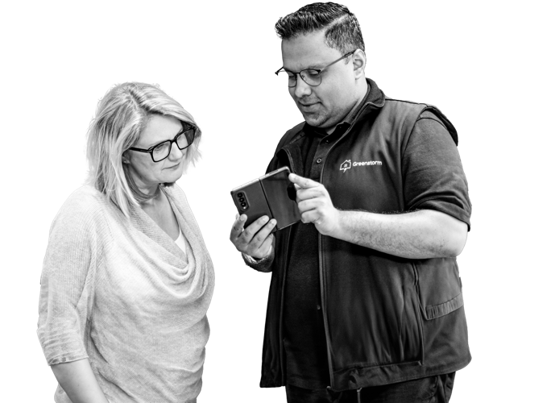
Engagement
Impact
Evidence

Slide 39
Events & webinars
"The webinars you’ve been doing have created a lot of traction internally within the Hub and our peers”
South West Net Zero Hub
NZG has run over 60 events to date, with around 2000 different attendees, enabling conversations and bringing the sector together
“I did find the webinar quite useful, we were working on an application for swimming pool grants, Sports England funding. It was really near to the deadline, through a post on the discussion site I was able to find the information (fund design notes & case studies) and provide to my colleagues writing the bid. It saved us time and we were successful in the application.”
Tandridge District Council
“The most useful webinars I have attended to so far, and the variety of resources in the portal looks very interesting“
Surrey County Council

Slide 40
E-learning
“The content and detail within the modules was excellent and pitched at a good starter level”
Anonymous
“The content of the e-learning provides a good introductory-level understanding of finances and funding for Net Zero initiatives.”
Anonymous
NZG has helped upskill the sector:
7 programmes published
1500+ modules completed
170+ programmes completed so far
4.3/5 average score of “How much did this e-learning programme help you build your skills?”
“Very useful to focus the mind on the essential elements of a building decarbonisation project”
Anonymous
“Would recommend this to planning & housing teams - to build awareness of low carbon options.”
South Oxfordshire District Council
“I would recommend this to entry level project officers.”
Derbyshire County Council

Slide 41
Knowledge sharing
“When I'm struggling, we get consultancy support to bridge the gap. That's why your platform has been so helpful. When I see your case studies, I'm able to understand what I need to do. Your platform is amazing in that sense"
Rossendale Borough Council
"Provision of business case templates so useful”
South Kesteven District Council
NZG has proliferated knowledge and best practice:
30,000+ views of knowledge articles
1,900+ file downloads
1,300+ views of Guides
1,000+ views of case studies
Top 10 content pieces:
Car park space calculator (585)
Business Model: Sleeved PPA (524)
NOABL windspeed database (489)
Business Model: Private Wire (462)
Outline business case template (439)
Guide: Decarbonising public sector buildings (434)
Guide: Fleet decarbonization (417)
Guide: Domestic retrofit measures (376)
Guide: Types of business case and the development process (367)
NIE Network capacity map (352)
"Net Zero go has provided us with excellent case studies and access experience we wouldn't otherwise have”
Rother District Council
“In terms of particular section that has particularly added value for me, this would be the document “Financing Local Net Zero Projects – A Guide for Local Authorities” and the associated checklist. It’s particularly relevant to where our LA is at the moment, and an area where there is less direct experience in the traditional sustainability, energy, housing teams that are aiming to deliver these types of projects. It’s converted quite a lot of unknown-unknowns into known-unknowns that we can now work through addressing"
Brighton & Hove City Council
“Louise informed the group that Behaviour Change projects were difficult to get off the ground but using the capabilities matrix in Net Zero Go has helped provide an evidence base to allow her to take this work forward in the South West”
NZG Hubs December 2023 Advisory
“NZG is a very useful resource, especially being able to point people towards case studies”

Slide 42
Amplification and dissemination
“It's a very useful platform for accessing and sharing information”
Anonymous
NZG has amplified the work of others
Published 800+ content pieces referencing the work of others in the sector
Amplified this work via promotional activities:
Sent 68,000+ promotional emails
Made 200+ social posts
Generating in 47,500+ impressions
Resulting in 8,000+ clicks out from NZG to these external resources
“Yes, I have heavily recommended it to colleagues - it’s our google for things”
London Borough of Barnet”
“It’s a very good pool of decent docs - realistic stuff and not air”
Anonymous
“[Net Zero Go has] Increased South West Net Zero Hub awareness“
South West Net Zero Hub

Slide 43
Connecting the sector
"Very useful insights and connections with other LAs that have developed commercial solar programmes, this information will be used as a basis for the development of our own programme"
Surrey County Council
“The forum is a good place to discuss and share knowledge”
Dudley Council
I also find the collaborative aspect really valuable - when other people ask questions you wouldn’t have thought of yourself, and you get different perspectives.
LCRCA
NZG has helped connect the sector
400+ Forum posts
1800+ Group memberships
Across 14 Groups
5 Groups with over 200 members
100+ Forum posters
250+ regular Forum visitors
It’s really helpful to have a contact name on a case study if you want to reach out to that person.
Devon County Council

Slide 44

What would happen if we weren’t here?

Slide 45

Net Zero Go – value for money for stakeholders
What if NZG did not exist?
Without an enduring library - knowledge gets lost
When projects finish, after documents have been published, events have been held and so on, Net Zero Go provides an actively managed home for these insights, where it can continue to benefit users. Without Net Zero Go, these insights could become lost or inaccessible, or many different knowledge platforms would have to be maintained (at much greater cost).
Strategic projects may not reach their target audience
Net Zero Go provides an effective mechanism for reaching many local authority officers, in a segmented and targeted way. Without this mechanism, the impact from these projects can be hamstrung, since they don’t reach a wide audience. Or, money is spent inefficiently on marketing and outreach activities within these projects.
Collaboration is made more difficult
‘When I’m looking for something we haven’t done yet, like mapping data centers, it’s a good place to find potential approaches. It saves us from having to contact each council individually, which is what we would have done before.’
Training a transient workforce is difficult
Local authority staff have high turnover rates, and often leave once experience and skills have been gained. With Net Zero Go, new staff can sign up and see programme outputs straight away, alongside resources tailored specifically for new officers.
So LA officers can come to the Hubs having already acquired basic training and knowledge, and ready to engage with Hubs and understand strategic programme outputs.

Slide 46
Net Zero Go – value for money for users
What if NZG did not exist?
Working from unreliable information
The sector’s knowledge is fragmented, and high-quality resources are often buried. Without Net Zero Go, local authority staff may be working from unverified resources found via Google.
“It’s our Google” “Good pool of docs – realistic stuff and not air”
“'This is where you’ll find solid resources, ones that have been created, checked, and tested to make sure they’re reliable’.”
Money spent on training
Typical costs for a 1-day training course for 8 people can top £1000. Net Zero Go provides a free alternative for new local authority staff looking to upskill and deliver projects. By comparison, a training courses for all of Net Zero Go’s 1500+ users would cost ~£200k per day.
“'Very useful to have all information and training in one place, and the fact its free is a great bonus.”
Less access to experts and expertise
Local authority teams are hungry for expertise, and Net Zero Go’s resources and events provide access to the sector’s expertise.
“I think it’s really useful because, before that, we were just searching the internet for information to fill in our knowledge gaps.”
More money spent on consultants
Local authorities often hire consultants to work on projects, when there is a knowledge gap, skill gap, or resource gap in their staff.
Net Zero Go upskills staff so that this need is reduced.
"We often get consultancy support to bridge the gap. That's why your platform has been so helpful. When I see your case studies, I'm able to understand what I need to do"
Less efficient work and opportunities missed e.g fund applications
Local authority teams are stretched, and fund applications often have sudden and tight deadlines. Without Net Zero Go’s resources and guidance, more local authorities would have to pass on certain applications (or not be aware of certain funds in the first place!)
“we were working on an application for swimming pool grants, Sports England funding. It was really near to the deadline, through a post on the discussion site I was able to find the information (fund design notes & case studies)… It saved us time and we were successful in the application. ”

Slide 47

User Engagement

Slide 48






User Feedback Group
What is it?
What’s in it for members?
feedback-sharing sessions and co-creation
The User Feedback Group is a panel of users invited to test new content, features, designs, and functionalities before they are rolled out to a wider audience. By participating, members help ensure that Net Zero Go aligns with user needs.
Role | Organization
Housing Retrofit Office | Liverpool City Region Combined Authority
Sustainable Development Officer | Aberdeenshire Council
Climate Change Manager | Borough Council
Environmental Project Officer | West of England Combined Authority
Project Manager Climate Change | Northumberland County Council
Sustainability and Climate Change Officer | Hart District Council
Members will play a key role in shaping the future of Net Zero Go by providing user feedback that directly influences its development to better meet user needs.
Members will connect with like-minded professionals from local authorities, expanding their professional networks
Members will have opportunity to raise their profile within the net zero community and become Net Zero Go Ambassadors by promoting the platform used by peers across the UK
Members will have opportunity to engage in discussions, workshops, and Q&A sessions with peers, sharing knowledge and learning from others working in similar fields.
Members will be among the first to test new content, features, designs, and functionalities of the Net Zero Go platform before they are released to the wider public.
Voluntary Membership
There is no obligation to remain in the group if circumstances change, allowing members to participate at their own convenience.
The group consists of six energy project officers from across the UK, all with a special interest in improving Net Zero Go and participating in feedback-sharing sessions and co-creation. The table on the right represents the list of members' roles and their respective local organizations.
Who is it?
Purpose
To test new features, designs, and functionalities before they are rolled out to a broader audience. This ensures that the NZG meets user expectations and needs
To collect direct, qualitative insights from users about their experiences with using NZG
To support the development of a user-centric products by providing ongoing input that ensures the design, navigation, and content are intuitive and engaging for end users.
To observe and analyse how users interact with new content or features after release, providing insights into the success of the implementation and areas for further refinement.
To create a strong connection between the product team and the user base, fostering a sense of ownership and loyalty among users.
To build a community of end user acting as ambassadors for the product within their networks
48

Slide 49
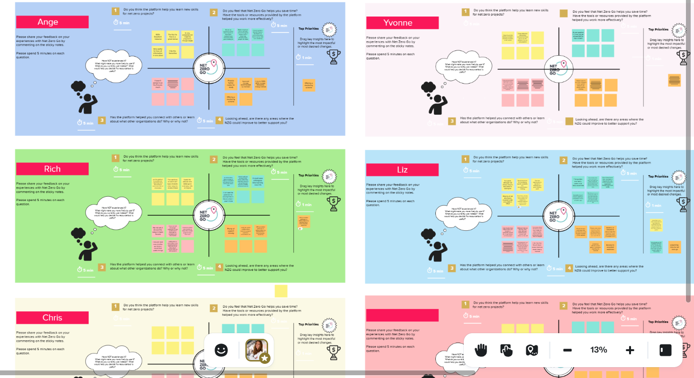
User Feedback Group
IMPACT OF THE GROUP
Testing new features and designs before a broader rollout ensures that Net Zero Go aligns with user expectations, improving the likelihood of user satisfaction and adoption.
Collecting qualitative insights directly from trusted and invested users allows for a deeper understanding of their experiences, leading to more informed adjustments and improvements to the product.
Continuous input from users helps shape a more intuitive and engaging product by refining the design, navigation, and content based on real-world feedback.
Observing and analysing user interaction with new content or features after release helps gauge the effectiveness of implementations and highlights areas that may require further refinement.
Strengthening the relationship between the product team and the user base fosters a sense of ownership and trust, ensuring that users feel valued and invested in the success of Net Zero Go.
Building a community of energy officers who act as ambassadors helps spread awareness and increase product credibility, creating a strong network of support and advocacy for the product.
Launching Event - Workshop
20.02.2025
OUTCOME
OUTPUT
We shared insights and all feedback on the Mural Board.
We hosted the launch event on February 20th in the form of a workshop, reflecting on the impact that Net Zero Go has had on each participant.
We’ve already seen connections forming within the group, as during the meeting two members were planning to connect later.
We have real connections!
49

Slide 50
Summary

Slide 51
Summary
Strong Evidence
This report confirms strong evidence that Net Zero Go delivers on its three strategic goals: building capacity, enhancing capability, and collaboration for local authorities. Our conclusion is based on impact hypothesis, each backed by solid evidence, both qualitative and quantitative.
Impact Hypothesis
NZG helped to build the capabilities of local authority officers – through resources such as e-learning they gained new skills, knowledge, and competencies to deliver projects they couldn’t before.
The resources on NZG such as best practice guides improved the capacity of UK local authorities to deliver projects by accelerating their work, enhanced the quality, and converted risks or unknown unknowns into items for mitigation.
NZG helped local authorities collaborate and share insights through the platform’s case studies and Forum questions and answers.
Our events promoting NZG helped showcase best practices and encourage cross-regional collaboration.
NZG helped local authorities to make funding applications, which they might not have made before due to lack of awareness, tight deadlines or unclear information.
Commitment to ongoing impact monitoring
Given the nature of Net Zero Go’s focus on building skills, competencies, capacities, some evidence of outcomes and impact may not yet be available. Therefore, we are committed to continuously monitoring the platform’s usage by local authority officers and stakeholders and assessing its direct impact over time.
Meaningful difference
Our assessment, based on provided evidence, confirms that Net Zero Go is making a meaningful difference in helping local authority officers accelerate net zero projects.

Slide 52

Looking Forward
Impact Led
We are committed to ensuring that Net Zero Go delivers real impact by strengthening the capacities, capabilities, and collaboration of local authorities on their journey to net zero. By prioritizing real-world outcomes, we can be confident that the resources we provide drive meaningful change. As we move forward, we remain dedicated to amplifying these efforts, accelerating the transition to net zero at the local level.
Stakeholder Collaboration
We believe that together we go further, and invite our stakeholders to drive change alongside us, collaborating to accelerate net zero local projects.
User Friendly
Great products are built with users' needs at their core. We are committed to continually gathering user insights, feedback, and engaging with users and experts in co-creation to ensure Net Zero Go remains user-friendly and accessible, offering practical tools and ready-to-use resources for all.
Agile
The road to net zero is unpredictable, with a constantly shifting landscape. Our agile approach keeps us adaptable, building on successes and closing gaps to maximize impact.

Slide 53
Appendix

Slide 54
Theory of Change
Inputs
What does the intervention involve?
How is it delivered (e.g. consultancy, funding, advice)?
How much support do those participating receive (e.g. time spent)?
GSENZH & DESNZ funding
ESC resource to run the project
Research by ESC on users & LA insights
IBM technical expertise (subcontracting for ESC)
Salesforce platform & other technology providers
Expertise from ESC, DESNZ, strategic partners i.e. Hubs, Case Study & content providers
Activities
What work will be undertaken using the inputs (e.g. search, pilots etc.)
Administration & configuration of Net Zero Go website portal & user interface
Expert research & production of content
Build of tools for refining & building project data, business cases, applications etc.
Technical support for users
Collaboration with industry innovators on user-identified subjects
Establishment & moderation of protected collaboration space for LA users
Outreach to users & community management
Outputs
What will be produced as a result of / in undertaking the activities (e.g. evidence reports, guidance documents, recommendations etc.)
Publication of Net Zero Go website portal
Publication of produced content via the portal & dissemination of external content
Deployment of tools for refining & building project data, business cases, applications etc.
Innovator workshops & expert webinars
LA users (& strategic partner users & delivery partner users) able to access NZG
LA users able to access content, use tools, build projects & business cases, browse & contribute to collaboration Forum
Over what time-period will these be produced?
23.04.22 -> ongoing
What monitoring data is being collated?
Website usage metrics
User feedback
Outcomes
What do you expect those receiving support to change/ or do in response to the support/intervention? (i.e. what might the outcomes be)?
Using NZG, LA officer was able to upskill and improve competency in 1 of NZG’s 30 capabilities
Using NZG, LA officer was able to more efficiently deliver project / business case / funding application (faster, further or time & money saved)
Use case studies to understand risks, lessons learned
Use best practice, Plan of Work & other project guidance to remove guesswork & risk from projects
Using NZG, LA officer was able to share experiences, resources and expertise?
Prioritise activities & projects based on experiences from other LAs
Use shared resources to avoid having to re-invent the wheel
Gain support from regional support organisations faster
Collaborate regionally?
Over what time-period would you expect Outcomes and Impacts to arise?
04.22 -> ongoing
Long-term Impacts
What impacts will these changes bring about?
More projects
Bigger projects
Better projects (more reliable, replicable, robust, de-risked)
Faster projects
Carbon & co-benefits achieved via projects (carbon saved, bills reduced, air quality improved etc.)
Money saved (on suppliers, consultants, upskilling etc.)
Time saved
More funding applications
Better quality funding applications

Slide 55
Energy Systems Catapult's logic model – Public Sector Decarbonisation example
Inputs.
We take:
IN1: Catapult employees, skills and knowledge
IN2: Catapult models, tools, frameworks, databases etc.
IN3: “Assets”/facilities such as Living Lab, Home Truths panel, Smart Local Energy Systems toolkit, etc.
IN4: Existing Catapult programmes and relationships
IN5: Income: Innovate UK core grant; CR&D funding; other grant funding; commercial revenues
Activities.
We use these to:
A1: Support innovators to:
  A1a: Help them understand the energy system, market and consumers
  A1b: Test, develop and demonstrate innovative energy products, services and value propositions in a real-world context, incl. with vulnerable consumers
  A1c: Test and develop business models, help them raise investment and funding, and win customers in the UK and internationally
A2: Work with places and complex sites to accelerate deployment of innovative energy products and services and upskill the supply chain
A3: Run collaborative R&D projects
A4: Do high-quality research, policy research, modelling and analysis across the whole energy system
A5: Develop Catapult assets and products to help innovators and other energy system actors commercialise and invest in innovative clean energy solutions
A6: Convene and lead industry and wider ecosystem taskforces to address specific barriers to innovation in the energy system:
  E.g. Digital, data taskforces, EV Energy Taskforce
Outputs.
We create / help others create:
OP1: Insights and evidence to drive rapid transition in the sector e.g. through reports, models, and data; which we communicate on an open basis and use to influence key audiences
OP2: Improved products and services, and investable business plans and investment cases, for innovators
OP3: Investable local energy transition plans and plans for decarbonising complex sites
OP4: Sector-wide approaches, methodologies and “roadmaps”
OP5: Recommendations to decision makers - government, regulators and other energy system actors - that will result in vibrant markets for energy innovation
OP6: Enhanced Catapult assets, products, tools and capabilities, such as our Living Lab, models, Home Truths consumer insight panel, etc.
Outcomes.
As a result:
OC1: UK innovators scale-up:
  OC1a: launch new/improved products, services and business models, including for vulnerable consumers;
  OC1b: grow sales;
  OC1c: win funding and investment;
  OC1d: increase direct employment
(in the UK and internationally)
OC2: The UK public and private sector make effective decisions about the energy transition and:
  OC2a: invest in innovative energy products and services,
  OC2b: decarbonise places and complex sites
  OC2c: build and scale supply chains for UK firms
OC3: Government, regulators and other energy system actors adopt policies that enable innovation, taking a whole-system view, opening new markets and accelerating progress towards net zero
OC4: Collaboration, relationships and best practice sharing are improved across the sector
OC5: Energy system actors are increasingly making data openly accessible and useable.
Impacts.
Driving long-term benefits for
the UK:
I1: Direct benefits to sector:
I1a: Growth in UK firms’ turnover
I1b: Growth in UK employment
I1c: Growth in investment
I2: Wider benefits:
I2a: Reduction in GHG emissions – ultimately realising a net zero energy system
I2b: Faster, cheaper, fairer and more socially acceptable transition to net zero
I2c: Improved air quality and associated health outcomes
I3: Support for “levelling up” as local areas and complex sites receive investment in decarbonisation
Notes:
FOCUSING ON OUTPUTS - IMPACTS

Slide 56
Impact Survey
Impact Breakdown - Capability, Capacity, Collaboration
High scores of Neutral responses across the survey, especially on capacity-building (up to 60%)
Brief Overview
Sample & timeframe
23 anonymous Net Zero Go users
Jan & Feb 2025
Capability
Capacity
Collaboration
Nearly
45%
65%
55%
Purpose
Assessing impact against capability, capacity, and collaboration
of respondents agree or strongly agree to capability building claim
of respondents agree or strongly agree to capacity building claim
of respondents agree or strongly agree to capability building claim
65% of respondents have reported time-saving benefits
More than half said that Net Zero Go helped them to better plan or deliver projects
in speaking about Net Zero
Lowest agreement with helping to secure funding suggests that there is significant potential to improve the platform’s ability to support users in this area
Increased knowledge of Net Zero in
nearly 70% of respondents
Increased confidence
in speaking about Net Zero in 60% of respondents
Improved understanding
of Net Zero projects amongst 80% of respondents
Almost 70% of respondents thanks to Net Zero Go learnt from other local authorities
Almost 40% agreed or strongly agreed that Net Zero Go helped them to engage with others
Key Takeaway
Strongest agreement on improved knowledge, but mixed feedback on capacity building.

Slide 57
Impact Survey
Key Insights & Quotes from users
The positive feedback (with around 65% agreement) across suggests that the Net Zero Go platform is making a measurable impact on knowledge-building, confidence, and understanding.
Quotes
Capability
A fantastic resource. I use it as a first place to find my known unknowns on any new type of net zero project.
The platform is effectively helping users streamline their work, save time, and help to plan and deliver projects.
Opportunity for growth for Net Zero Go lies in funding support and helping users to write better quality outputs
A significant portion of respondents selected "Neither Agree nor Disagree" (Score 3) across key survey questions, especially in capacity building question. This pattern may indicate a lack of confidence, mixed experiences, or a need for more clarity on the question.
Especially like the 'Forum' function for people to have an open discussion on the queries raised.
Capacity
Net Zero Go is successfully facilitating knowledge-sharing between local authorities
While some users are benefiting from engagement opportunities, there is room to enhance the platform’s ability to connect people more effectively
Found it quite useful in looking at case studies where new types of low carbon heating has been used.
Collaboration

